Slide 1
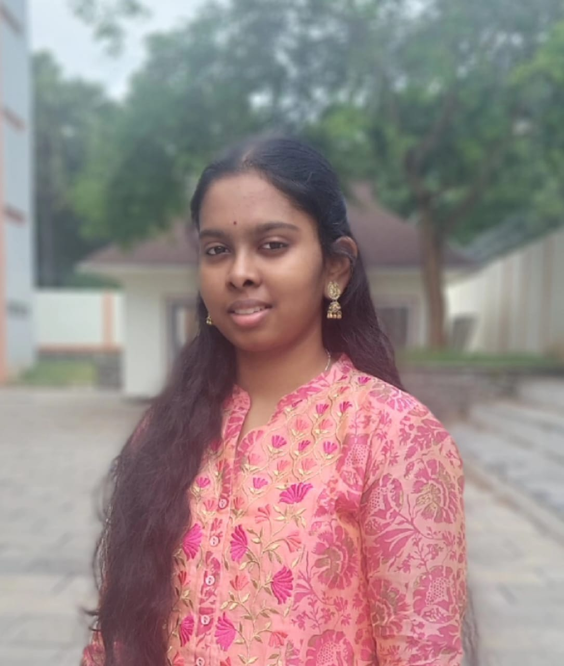
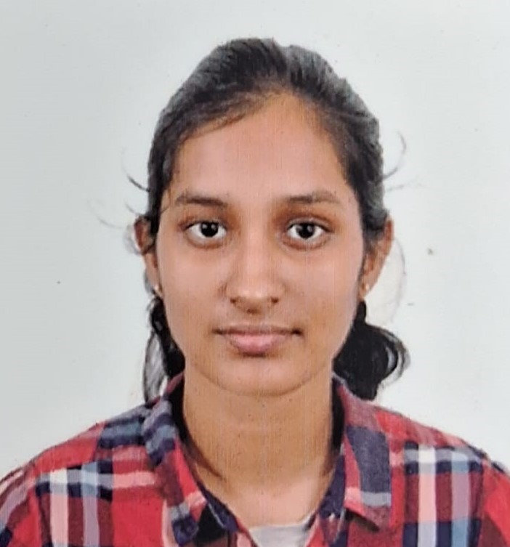

Paddy Disease Detection
Name: Darneshwar, Keerthana, Preethi
Roll No: CSE21309,49,65
Prof .Dr. Bagyammal T.

Slide 2
Agenda
Introduction
Literature survey
Challenges
Dataset description
Methodology
Data analysis
ML model
DL model
Explainable AI
Conclusion
Future Enhancement

Slide 3
Contributions
Roll.No | Name | Contribution (Architecture Name)
CB.EN.U4CSE21309 | DARNESHWAR | Xception
CB.EN.U4CSE21349 | KEERTHANA | VGG
CB.EN.U4CSE21365 | PREETHI | Inception

Slide 4
Problem Statement
Develop advanced machine learning and deep learning models to accurately classify diseases in paddy crops from images. Leveraging state-of-the-art computer vision techniques, the project aims to enable early detection and diagnosis, improving crop management

Slide 5
List of Benchmark datasets
https://www.kaggle.com/datasets/imbikramsaha/paddy-doctor
Classes['bacterial_leaf_blight', 'bacterial_leaf_streak', 'bacterial_panicle_blight', 'blast', 'brown_spot', 'dead_heart', 'downy_mildew', 'hispa', 'normal', 'tungro’]
https://www.kaggle.com/datasets/badhon7432/paddyleafdiseaseuci/data
['Brown spot', 'Leaf smut', 'Bacterial leaf blight’]

Slide 6
Analytical Questions
Simple
1.Which paddy disease is most frequently misclassified by the model?
2. What is the average time taken by the model to classify an image?
Medium
3. How does the model's performance vary across different environmental conditions (e.g., lighting, background, etc.) in the images?
4. How does the model perform when trained and tested on images from different geographic regions?
Difficult
5.Can the model identify multiple diseases in a single image, and how accurate is this multi-label classification?
6. How well does the model perform in detecting early-stage symptoms of paddy diseases compared to advanced-stage symptoms?

Slide 7
Research Questions 28.8.24
Identify the model used for classifying the disease
What types of image used -> RGB/Grayscale
Existing model and the implementation going to be done

Slide 8
Introduction
Provide an introduction to the project.
Effective management of paddy crops is crucial for ensuring high yields and quality. This project focuses on developing a system for detecting diseases in paddy plants using advanced technologies. By leveraging machine learning , Deep Learning, explainable AI and image analysis, our goal is to create a reliable tool that helps farmers identify and address diseases early, ultimately improving crop health and productivity.
Give some statistical inference stating why this project is necessary.
1.Economic Impact of Paddy Farming:
Paddy rice is a staple food for more than half of the world's population, especially in Asia. According to the Food and Agriculture Organization (FAO), rice accounts for 20% of global calorie intake. Improving the efficiency and productivity of paddy farming can have a significant impact on global food security.

Slide 9
2. Prevalence of Crop Diseases:
Studies show that crop diseases can lead to up to 30% yield loss in paddy fields if not managed properly. The FAO reports that diseases and pests are major threats to
paddy crops, impacting not just the quantity but also the quality of the yield. Early detection is crucial for minimizing damage and losses.
3. Current Challenges in Detection:
Traditional methods of paddy disease detection often involve manual inspection by experts, which is time-consuming and prone to human error. According to research, manual inspection can have detection accuracies as low as 60-70%, while deep learning models can achieve accuracies above 90% in some cases.
Give Social relevance to the project.
This project enhances food security by improving paddy crop health, directly impacting millions of farmers and consumers. Early disease detection boosts yields, reduces economic losses, and supports sustainable agriculture, contributing to community well-being and resilience in rice-dependent regions.

Slide 10
List of Products similar to this project
Product Name | URL | Features
Paddy Doctor | https://paddydoc.github.io/ | Dual-Spectrum Detection
AppPADI | https://github.com/rifqinvnd/Rice-Disease-Prediction-Application | Integrated Disease Management
Rice Doctor | https://www.irri.org/rice-doctor | wide range of diagnostic options (80 diseases)
riceXpert | http://www.ricexpert.in/ | Digital tool designed for monitoring and managing paddy crops
Paddy Inspector | https://github.com/paddydoc/paddydoc.github.io | automated identification of diseases and pests in paddy

Slide 11
List of Research Labs
Name of the lab | URL | Name of the Professor | Institute | Country
Agricultural Innovation and advanced learning Lab | https://research.vit.ac.in/researcher/ramesh-kumar-s-1 | Prof.Ramesh Kumar S | Vellore Institute of technology | India
Lingnan Guangdong Laboratory of Modern Agriculture | https://www.nature.com/nature-index/institution-outputs/china/guangdong-laboratory-for-lingnan-modern-agriculture-scau/5e8a8b7a24d592033f6894f9 | Prof.Long Qi | South China Agricultural University, | China
Jilin Precision Agriculture and Big Data Engineering Research Center, Changchun | https://ieeexplore.ieee.org/author/38194560500 | Prof. Helong Yu | College of Information Technology, Jilin Agricultural University | China

Slide 12
1. A Novel Fine-Tuned Deep-Learning-Based Multi-Class Classifier for Severity of Paddy Leaf Diseases
Authors: Shweta Lamba, Vinay Kukreja, et al.
Published In: Frontiers in Plant Science, 2023
Overview: This paper presents a hybrid approach that combines Convolutional Neural Networks (CNN) and Support Vector Machines (SVM) to classify the severity of paddy leaf diseases. The dataset comprises 4,068 images sourced from various online repositories.
Methodology: The dataset was augmented using Generative Adversarial Networks (GAN) to improve model training. The model categorizes disease severity into four levels: mild, moderate, severe, and profound.
Results: The model achieved an accuracy of 98.43% in predicting the type and intensity of diseases such as bacterial blight, blast, and leaf smut, demonstrating its effectiveness in practical applications.
2. Rice Plant Disease Diagnosing Using Machine Learning Techniques: A Comprehensive Review
Overview: This review article surveys multiple machine learning techniques applied to the diagnosis of rice plant diseases, with a specific focus on CNNs.
Findings: The review discusses the effectiveness and limitations of various approaches, providing a comprehensive understanding of the current state of research in rice disease detection. It highlights the need for improved algorithms and datasets to enhance diagnostic accuracy.

Slide 13
3. Stacking-Based and Improved Convolutional Neural Network: A New Approach in Rice Leaf Disease Identification
Overview: This study introduces a stacking ensemble model that integrates multiple CNN architectures (including improved AlexNet, GoogLeNet, ResNet50, and MobileNetV3) along with SVM as a sub-learner.
Methodology: The model leverages an attention mechanism to focus on disease-specific features, improving the classification of rice leaf diseases.
Results: The proposed model achieved a remarkable accuracy of 99.69%, showcasing its potential for effective disease identification in agricultural settings.
4. GoogLeNet Based on Residual Network and Attention Mechanism Identification of Rice Leaf Diseases
Overview: This paper explores a modified GoogLeNet architecture that incorporates residual networks and attention mechanisms to enhance the detection of rice leaf diseases.
Findings: The integration of these advanced techniques aims to improve the model's focus on relevant features, thereby increasing the accuracy of disease classification.

Slide 14
Detection and Classification of Paddy Leaf Diseases Using Deep Learning (CNN)
Authors: S. Maheswaran, S. Sathesh, P. Rithika, I. Mohammed Shafiq, S. Nandita
Published: SpringerLink
Summary: This paper presents a deep learning approach using Convolutional Neural Networks (CNN) to detect and classify diseases in paddy leaves. The study demonstrates high accuracy in identifying multiple types of diseases, making it a valuable tool for agricultural management.
A Survey on Paddy Crop Disease Detection Using Machine Learning and Artificial Intelligence Models
Authors: N. Chakraborty, R. Nanda, K. Das
Published: SpringerLink
Summary: This paper surveys various machine learning and AI models used for detecting diseases in paddy crops. It highlights the advantages of using these advanced techniques over traditional methods, offering insights into future research directions.
Seasonal Crops Disease Prediction and Classification Using Deep Convolutional Encoder Network
Authors: A. Khamparia, G. Saini, D. Gupta, A. Khanna, S. Tiwari, V.H.C. de Albuquerque
Published: Circuits Systems Signal Processing
Summary: This paper discusses a deep convolutional encoder network designed for predicting and classifying diseases in seasonal crops, including paddy. The model shows significant promise in real-time disease monitoring and prevention.

Slide 15
Paddy Crop Disease Prediction—A Transfer Learning Technique
Authors: S.S. Rautaray, M. Pandey, M.K. Gourisaria, R. Sharma
Published: International Journal of Recent Technology and Engineering
Summary: The authors explore the use of transfer learning in predicting paddy crop diseases. The study emphasizes the efficiency of transfer learning models in achieving high accuracy with limited data, making it ideal for resource-constrained environments.
Identification and Recognition of Paddy Diseases and Pests Using Convolutional Neural Networks
Authors: C.R. Rahman, P.S. Arko, M.E. Ali
Published: Biosystems Engineering
Summary: This paper investigates the application of CNNs in identifying and recognizing diseases and pests in paddy fields. The research focuses on improving the robustness of detection systems under varying environmental conditions.

Slide 16
Problem Statement
Given a dataset of MNIST, the proposed model will do the following.
Understand the characteristics of MNIST, and identify the insights to develop the model with ensured quality.
To utilize conventional machine learning algorithms such as Support Vector Machines, K-Nearest Neighbors, and Random Forests to classify handwritten digits, and conduct a comparative analysis to evaluate their performance.
Apply deep learning techniques, such as convolutional neural networks (CNNs) and variants of transfer learning techniques to classify handwritten digits, and conduct a comparative assessment to evaluate their effectiveness in handling the MNIST dataset.
Incorporate eXplainable Artificial Intelligence (XAI) methodologies like SHAP (SHapley Additive exPlanations), LIME (Local Interpretable Model-agnostic Explanations), to offer insights into model predictions and improve interpretability.

Slide 17
Motivation
The proposed solution facilitates early disease detection in paddy crops, thereby reducing losses and improving food security.
Dataset : High-quality, annotated datasets with images from diverse conditions and early disease stages are crucial for training robust machine learning models.
Algorithms: machine learning techniques, such as CNNs and transfer learning, improve classification accuracy by leveraging pre-trained models and extracting relevant features, potentially integrating temporal data for enhanced detection.
Economic Impact :Effective disease detection ensures stable paddy production, contributing to global food security and reducing economic losses for farmers by minimizing crop loss and pesticide use, thus improving overall agricultural productivity.

Slide 18
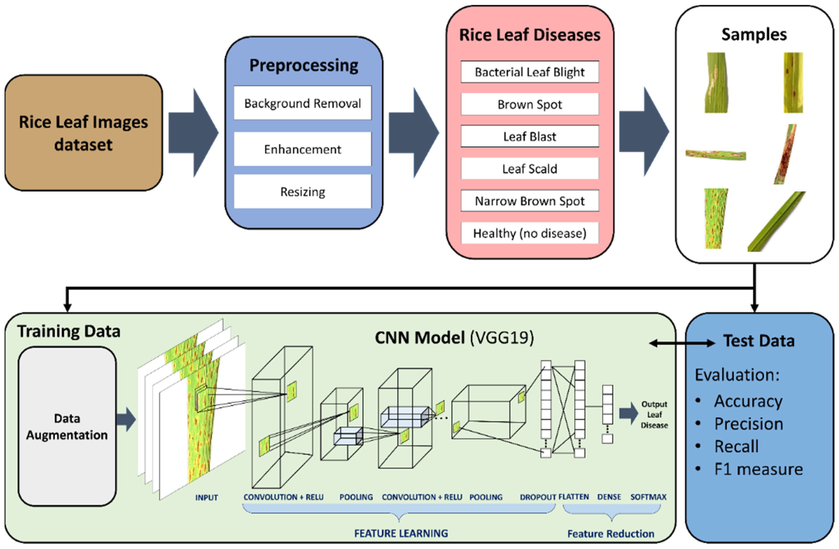
Block Diagram

Slide 19
Methodology
Section (i): Data Analysis
Section (ii): Machine Learning Model
Section (iii): Deep Learning Model
Section (iv): Explainable AI

Slide 20
Data analysis
Advantages:
Insight Generation: Helps in understanding patterns, trends, and anomalies in the data.
Decision Making: Facilitates data-driven decision-making by providing quantitative evidence.
Simplifies Complex Data: Breaks down complex datasets into understandable summaries and visualizations.
Problem Identification: Identifies issues and areas for improvement in data collection and processes.
Limitations:
Data Quality Dependence: The accuracy of analysis is highly dependent on the quality of the data.
Time-Consuming: Can be time-consuming, especially with large datasets.
Requires Expertise: Needs skilled analysts to interpret data correctly.
Static Insights: Provides insights based on historical data, not necessarily predictive.

Slide 21
Machine Learning model
Advantages:
Predictive Power: Can predict future trends and outcomes based on historical data.
Automation: Automates decision-making processes, reducing the need for human intervention.
Adaptability: Can adapt and improve over time with more data
Scalability: Applicable to various domains and can handle large datasets efficiently.
Limitations:
Data Dependency: Requires large amounts of high-quality data for accurate predictions.
Complexity: Models can be complex and difficult to understand or interpret.
Overfitting: Risk of overfitting to training data, leading to poor generalization.
Resource Intensive: Can be computationally expensive and require significant resources.

Slide 22
Deep Learning model
Advantages
High Accuracy: Often achieves higher accuracy than traditional machine learning models, especially in image and speech recognition tasks.
Feature Extraction: Automatically extracts relevant features from raw data, reducing the need for manual feature engineering.
Complex Data Handling: Excels at handling complex data types, such as images, audio, and text.
Scalability: Can process and learn from large-scale datasets.
Limitations
Data Hungry: Requires vast amounts of labeled data for training.
Computational Cost: Extremely resource-intensive, needing powerful GPUs and significant computational power.
Black Box Nature: Often criticized for being opaque and difficult to interpret.
Training Time: Training deep learning models can be time-consuming and requires significant effort in tuning.

Slide 23
Explainable AI
Advantages:
Transparency: Makes AI decisions and predictions more understandable to humans.
Trust: Increases trust in AI systems by providing clear explanations for their behavior.
Regulatory Compliance: Helps in meeting regulatory requirements for transparency and accountability.
Error Detection: Facilitates the identification and correction of errors and biases in AI models.
Limitations:
Complexity: Adding explainability features can increase the complexity of the model development process.
Trade-offs: There might be trade-offs between model accuracy and interpretability.
Limited Methods: Current XAI methods may not fully explain highly complex models like deep neural networks.
User Understanding: The explanations provided may still require domain expertise to be fully understood.

Slide 24
Types of Machine Learning
1.Supervised Learning:
Convolutional Neural Networks (CNNs)
Support Vector Machines (SVM)
Decision Trees
2.Unsupervised Learning:
K-means Clustering
Principal Component Analysis (PCA)
Autoencoders
3.Semi-Supervised Learning:
Semi-Supervised SVM
Graph-based Methods
Self-training Algorithms

Slide 25
Computer Vision Algorithms for the project
Convolutional Neural Networks (CNNs) (year:1989)
Strengths:
High accuracy and automatic feature extraction.
Effective for complex pattern recognition.
Applications:
Detects and classifies various paddy leaf diseases.
Examples include VGG, ResNet, and Inception models.

Slide 26
U-Net (year: 2015)
Strengths:
Excellent for image segmentation tasks.
Captures fine details and spatial context in images.
Applications:
Precise segmentation of diseased regions on paddy leaves.
Fully Convolutional Networks (FCNs) (year: 2014)
Strengths:
Converts traditional CNNs into segmentation models.
Allows for pixel-wise classification and segmentation.
Applications:
Segments diseased areas on paddy leaves.

Slide 27
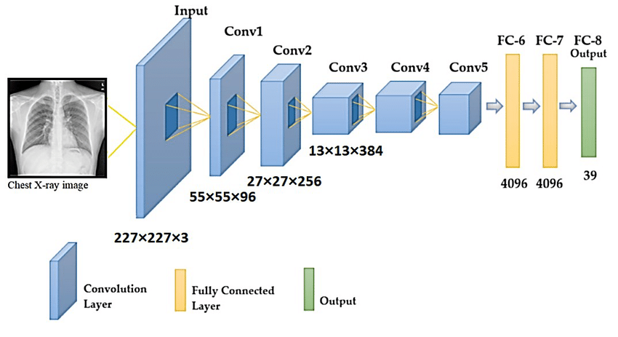
Architecture Diagram
For example see below:
Generate the architecture diagram: Check this link for the same - How to Visualize Neural Network Architectures in Python | by Angel Das | Towards Data Science

Slide 28
Algorithm Procedure
Explain how the deep learning architecture works ?
Explain the architecture in detail: Explanation must have step by step calculations for a given input (can be shown in diagram representation along with explanation)

Slide 29
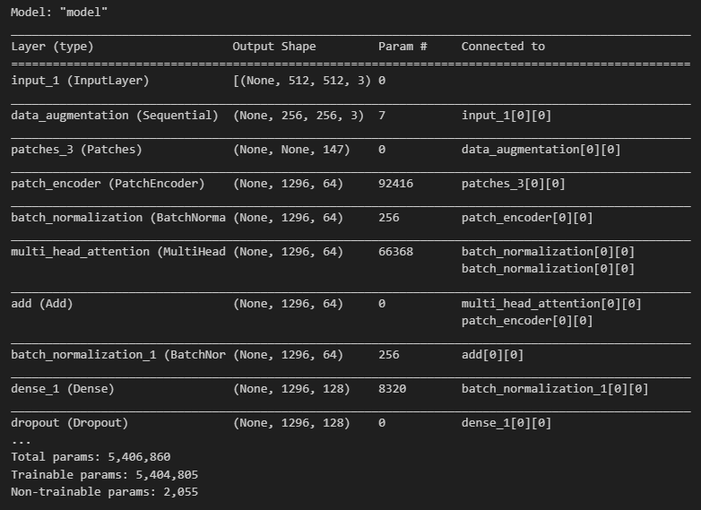
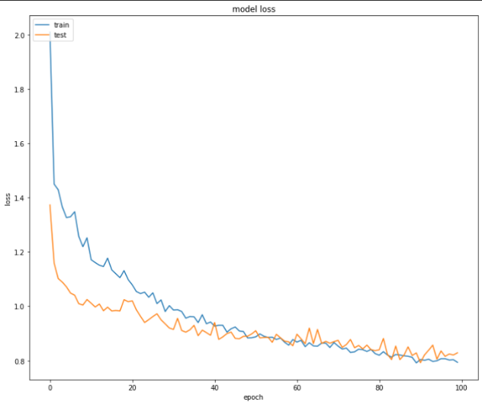
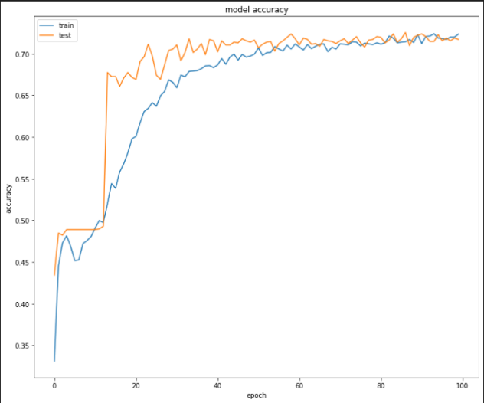
For example
Model
S.No | Epochs | Training Accuracy | Training Loss | Validation Accuracy | Validation Loss | AUC
1 | 1-20 | 0.58 | 1.11 | 0.47 | 1.01 | 0.87
2 | 20-40 | 0.60 | 0.96 | 0.51 | 0.90 | 0.89
3 | 40-60 | 0.66 | 0.87 | 0.68 | 0.89 | 0.90
4 | 60-80 | 0.71 | 0.84 | 0.70 | 0.85 | 0.915
5 | 80-100 | 0.72 | 0.81 | 0.72 | 0.82 | 0.917
Optimizer – Adam
Activation – Soft max
Loss Function – Categorical cross entropy
Epochs – 100
Regularization – Drop out
Precision: 0.3357
Recall: 0.4144
F1 Score: 0.3671

Slide 30

References
Note: Use IEEE citation format generator to provide thee references in IEEE format. Necessary info for getting the format is DOI.
Citations must be given for each reference. (Can refer the application named Litmaps for a graphical view. Follow this link Litmaps | Your Literature Review Assistant). In the next slide sample graph from Litmaps is shown for the datasets.

Slide 31
Paddy Disease detection
S KEERTHANA
CB.EN.U4CSE21349
Review-2
23.9.24

Slide 32
Review - 2
1.Introduction -3
2.literature survey –3
3.Features of the Deep learning architecture-2
4.Computer vision based approach -2
5.Methodolofy /approach -5 Mark
Diagram -3(including diagram drawn with deep learning tool)
Algorithm---2 mark
6.Why this architecture? ---2 mark
7.Hyperatameter table ---3 marks
8.Hyperparameter Tuning--2 mark
9.Set up planned ---2 marks
10.Formula for the performance metrics planned on the project --1 mark

Slide 33
INTRODUCTION
What is Computer Vision?
Computer vision is a part of artificial intelligence (AI) that helps computers understand and process visual information, like images and videos. This technology allows machines to perform tasks such as recognizing objects and faces, similar to how humans see and interpret the world..
What is Deep Learning in Computer Vision?
Deep learning is a method that uses neural networks to analyze visual data. It enables computers to learn patterns from large amounts of data, which helps them make accurate predictions for tasks like classifying images and detecting objects.
Why is Deep Learning Needed in Computer Vision?
enhances computer vision by improving accuracy, handling large datasets, enabling real-time processing, extracting complex features, and adapting to variations in visual data.
Example: Traditional methods fail in low-light conditions, but deep learning can learn to handle such variations by training on diverse data.

Slide 34
Computer Vision in Paddy disease detection
Automated Disease Identification: Computer vision models, such as convolutional neural networks (CNNs), are employed to identify and classify paddy diseases from images of rice plants.
Disease Severity Assessment: By analyzing leaf images, computer vision helps assess the severity of diseases, aiding in timely interventions and management strategies.
Deep Learning with Computer Vision
Feature Extraction: CNNs automatically learn and extract important features from images.
High Accuracy: Deep learning improves accuracy in tasks like object detection and image classification.
Real-Time Analysis: Models lenable fast real-time processing for applications like surveillance.
What Deep Learning Solves
Detects Complex Patterns: Captures intricate details in images.
Handles Large Data: Processes vast datasets for better accuracy.
Automates Tasks: Enables scalable, real-time image analysis.

Slide 35
Literature survey – paper 1
Paper Title: Deep learning model for detection of brown spot rice leaf disease with smart agriculture
[ https://doi.org/10.1016/j.compeleceng.2023.108659]
Summary of Findings
The proposed system utilizes a CNN-VGG19 model for detecting brown spot rice leaf disease, achieving an accuracy of 93.0%. This model employs transfer learning for precise identification, outperforming traditional methods.
Methodology
Data Collection: Gather images of rice leaves affected by diseases.
Preprocessing: Normalize images and prepare datasets for training.
Model Training: Train the CNN-VGG19 model for disease classification.
Evaluation: Compare results against baseline models using accuracy and other metrics.
Why This Architecture
High Accuracy: The CNN-VGG19 model achieves high precision in disease detection.
Transfer Learning: Leverages pre-trained weights to enhance performance.
Robustness: Effectively identifies diseases from varying image conditions.
Scalability: Adaptable for different rice diseases and agricultural settings.
Key Contributions
Developed a CNN-VGG19 model that significantly improves disease detection accuracy.Conducted a comprehensive literature review highlighting the need for automated disease recognition.Demonstrated the effectiveness of transfer learning in agricultural applications.
Achieved a sensitivity of 89.5%, surpassing existing baseline models.

Slide 36
Literature survey- paper 2
Paper Title: Convolutional Neural Network in Rice Disease Recognition: Accuracy, Speed, and Lightweight Summary of Findings: This paper reviews the application of convolutional neural networks (CNN) in rice disease detection. It highlights the effectiveness of CNNs in enhancing recognition accuracy, processing speed, and deployment on mobile devices. Key advancements include the use of lightweight CNN models to improve real-time performance and reduce computational requirements without sacrificing accuracy.
Methodology:
Data Collection: Rice disease images from various datasets, including field images and online sources.
Preprocessing: Images are augmented and preprocessed (e.g., resizing, noise reduction) to improve model training.
Model Training: Different CNN models such as VGG-19, InceptionV3, and DenseNet are trained on augmented datasets.
Evaluation: Models are compared using accuracy and computational efficiency, with a focus on lightweight architectures suitable for mobile deployment.
Why This Architecture:
Lightweight Design: The CNN models are designed to be lightweight, reducing the number of parameters and memory usage, which is crucial for real-time applications in agriculture.
Real-Time Efficiency: Enhancements in model structure (like pruning and quantization) enable fast identification of rice diseases, making it suitable for use in the field.
Transfer Learning: The use of pre-trained models on larger datasets (like ImageNet) reduces training time and improves accuracy on small rice disease datasets.
Key Contributions:
Detailed a lightweight CNN approach for rice disease recognition, improving mobile deployment feasibility.
Summarized existing techniques for enhancing recognition accuracy, including data augmentation and model compression.
Addressed challenges in real-time recognition by proposing efficient network structures and deployment strategies​

Slide 37
Literature survey – paper 3
Rice Plant Disease Diagnosing Using Machine Learning Techniques: A Comprehensive Review
Summary of Findings: This paper provides a comprehensive review of machine learning techniques used for diagnosing rice plant diseases. It highlights the effectiveness of deep learning models such as CNN, VGG-16, VGG-19, MobileNet, LeNet5, and ResNet-50 in identifying various rice diseases. The review finds that ResNet-50 is the most accurate model for rice disease detection, achieving superior results in terms of accuracy and training efficiency.
Methodology:
Data Collection: A range of datasets is used, some collected manually using devices like mobile phones and cameras, while others are publicly available (e.g., Kaggle).
Preprocessing: Techniques like image segmentation (K-means) and feature extraction (GLCM) are commonly employed.
Model Training: Various CNN architectures are trained for disease detection, with a focus on improving speed and accuracy.
Evaluation: The models are evaluated based on accuracy, precision, and recall. Hybrid models (e.g., combining VGGNet, DenseNet-121, and SE-ResNet-50) are shown to outperform traditional machine learning techniques.
Why This Architecture:
Accuracy and Efficiency: ResNet-50 and VGGNet are highlighted for their ability to accurately detect rice plant diseases while maintaining computational efficiency.
Transfer Learning: Pre-trained models are used to improve performance on smaller datasets.
Hybrid Approaches: The use of hybrid models, which combine multiple architectures, leads to improved performance in challenging disease recognition scenarios.
Key Contributions:
A detailed analysis of machine learning techniques for rice disease detection, identifying ResNet-50 as the best-performing model.
Highlighted the benefits of hybrid models, such as combining CNN architectures to improve accuracy.
Reviewed various deep learning applications in rice disease diagnosis and offered suggestions for future improvements​

Slide 38
Key Features of VGGNet architecture
High Detection Accuracy: VGGNet’s deep architecture captures subtle differences in rice leaf diseases, ensuring high accuracy across multiple disease types.
Efficient Design: With small (3x3) filters and uniform layers, VGGNet is simple to implement and fine-tune, making it ideal for agricultural tasks.
Powerful Feature Extraction: Its 16-19 layers capture detailed, hierarchical features, improving the identification of complex paddy diseases.
Boosted by Transfer Learning: Pre-trained on large datasets, VGGNet accelerates training on smaller paddy disease datasets, enhancing detection accuracy.
Scalable Across Devices: VGGNet adapts well to different hardware, making it suitable for real-time monitoring on mobile devices in smart agriculture.
Consistent in Varied Conditions: The architecture is robust against variations in lighting and angles, ensuring reliable performance in diverse paddy field conditions.
Adaptable and Tunable: VGGNet’s modular design allows easy fine-tuning, enabling flexibility in detecting both common and rare diseases.

Slide 39
Computer vision perspective of VGGNet architecture
.
VGGNet is recognized for its ability to capture detailed features through a deep architecture, making it ideal for image classification and fine-grained visual tasks.
Accurate Feature Hierarchy: VGGNet excels at extracting hierarchical features from images, allowing it to capture both fine details (e.g., textures) and high-level patterns (e.g., disease spots) crucial for tasks like object classification.
Deep Layered Structure: The deep structure (16 or 19 layers) of VGGNet enhances its ability to detect intricate visual features, improving accuracy in complex tasks such as medical imaging or agricultural disease detection.
Consistent Receptive Fields: With uniform 3x3 convolutional filters, VGGNet ensures consistent feature extraction across the image, making it well-suited for detecting subtle differences in image datasets like paddy disease detection.
Transfer Learning-Friendly: VGGNet's pre-trained weights on large datasets like ImageNet make it highly adaptable for transfer learning, reducing training time while maintaining high accuracy across different computer vision tasks.
Wide Applicability: Despite its relatively simple design, VGGNet performs well across a variety of computer vision tasks, from object recognition to segmentation, due to its reliable feature extraction capabilities.

Slide 40
REFERENCES
Senthil Pandi, S., Senthilselvi, A., Gitanjali, J., Arivuselvan, K., Gopal, J., & Vellingiri, J. (2022). Rice plant disease classification using dilated convolutional neural network with global average pooling. Ecological Modelling, 474, 110166. doi: 10.1016/j.ecolmodel.2022.110166
Aggarwal, M., Khullar, V., Goyal, N., Singh, A., Tolba, A., Thompson, E. B., ... & Jain, A. (2023). Pre-trained deep neural network-based features selection supported machine learning for rice leaf disease classification. Agriculture, 13, 936–959. doi: 10.3390/agriculture13050936
Arinichev, I. V., Polyanskikh, S. V., Volkova, G. V., & Arinicheva, I. V. (2021). Rice fungal diseases recognition using modern computer vision techniques. International Journal of Fuzzy Systems, 21, 1–11. doi: 10.5391/IJFIS.2021.21.1.1
Sethy, P. K., Barpanda, N. K., Rath, A. K., & Behera, S. K. (2020). Deep feature based rice leaf disease identification using support vector machine. Computers and Electronics in Agriculture, 175, 105527. doi: 10.1016/j.compag.2020.105527
Shrivastava, V. K., Pradhan, M. K., Minz, S., & Thakur, M. P. (2019). Rice plant disease classification using transfer learning of deep convolution neural network. International Archives of the Photogrammetry, Remote Sensing & Spatial Information Sciences, 42(3), W6.
Sethy, P. K., Barpanda, N. K., Rath, A. K., & Behera, S. K. (2020). Deep feature based rice leaf disease identification using support vector machine. Computers and Electronics in Agriculture, 175, 105527. doi: 10.1016/j.compag.2020.105527
Li, D., Zhang, Y., & Wang, Y. (2023). Rice Disease Detection Using Deep Learning VGG-16 Model and Flask Application Development for Farmers' Use. ResearchGate. doi: 10.13140/RG.2.2.19343.23206

Slide 41
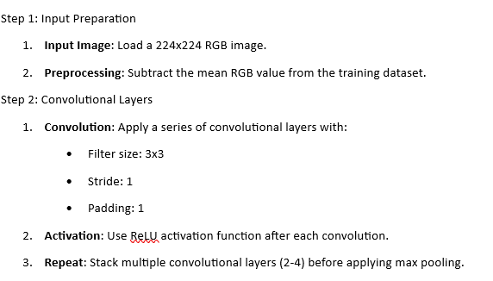
Algorithm - VGGNet

Slide 42
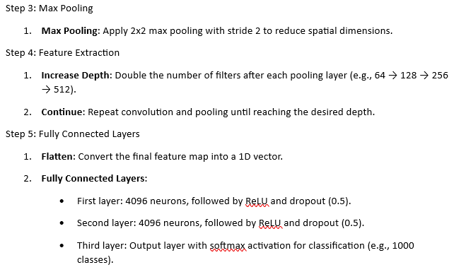
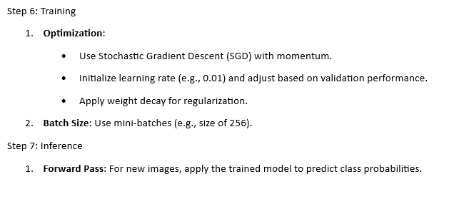

Slide 43
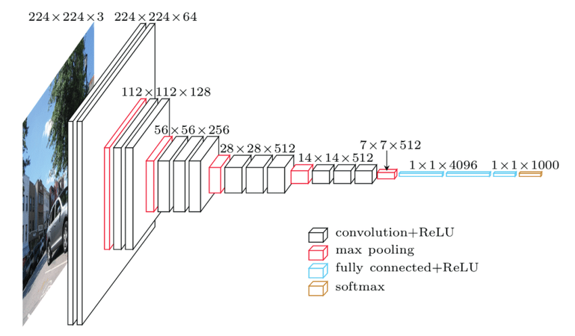
Architecture diagram

Slide 44
Architecture diagram using tools
NN-SVG
Draw-covnet python code

Slide 45
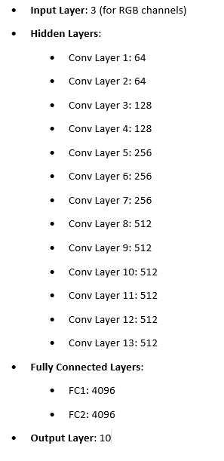
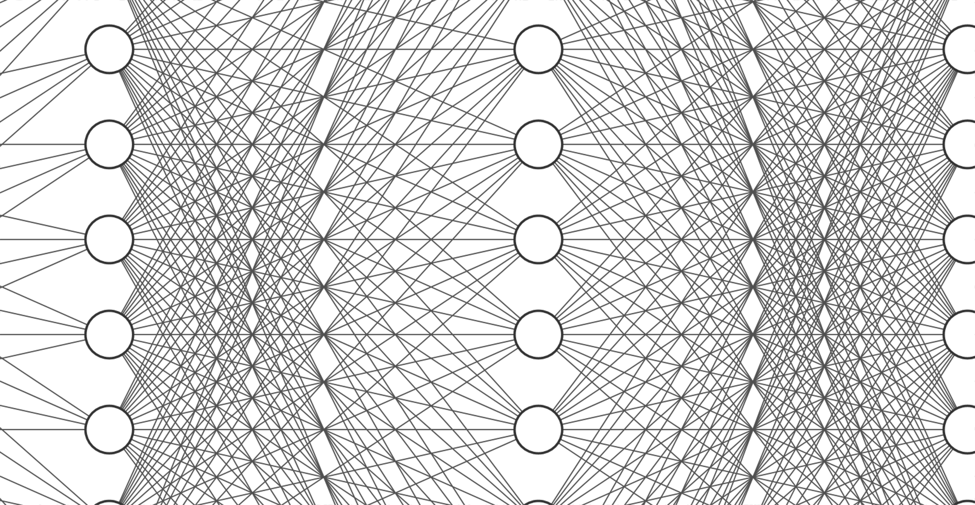
TOOL 1 :Example Configuration for VGGNet in NN-SVG
VGGnET shows part FCNN
*configuration with respect to the algorithm given

Slide 46
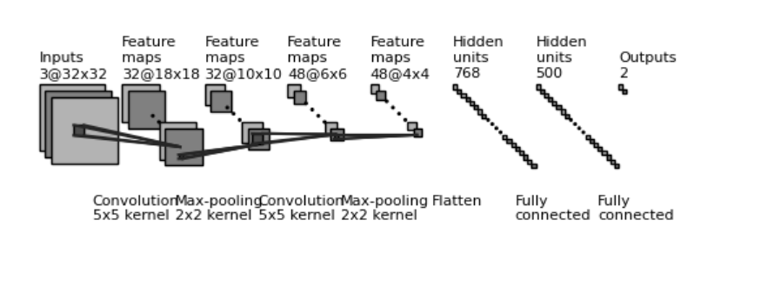
TOOL 2 : draw_convnet : /draw_convnet.py run the python code in google colab with matplotlib to generate the diagram image

Slide 47
Reasons for Choosing VGGNet for Paddy Disease Classification
High Accuracy: VGGNet's deep architecture (16-19 layers) captures intricate patterns and subtle differences in rice leaf diseases, ensuring high accuracy across multiple disease types.
Effective Feature Extraction: Small (3x3) convolutional filters enable VGGNet to extract hierarchical features, crucial for distinguishing between fine details in different paddy disease classes.
Transfer Learning Capability: Pre-trained weights from large datasets like ImageNet accelerate training on smaller paddy disease datasets while maintaining high accuracy.
Robustness to Variations: The architecture is designed to be robust against variations in lighting, angles, and backgrounds, essential for real-world agricultural applications.
Scalability Across Devices: VGGNet adapts well to different hardware platforms, making it suitable for real-time monitoring and mobile applications in smart agriculture.
Modular Design: Easy fine-tuning and adaptation to specific tasks, enabling detection of both common and rare paddy diseases without extensive re-engineering.
Established Performance: VGGNet has a proven track record in various image classification tasks, including medical imaging and agricultural applications.
Support for Multi-Class Classification: The output layer can handle 10 different paddy disease classes, making it well-suited for the task. (our problem is a 10 class classification problem)

Slide 48
Hyperparameter - VGGNet
Hyperparameter | Existing VGGNet | Proposed Architecture
Input Size | 224 x 224 x 3 | 128 x 128 x 3
Convolutional Layers | 13 | 5
Filter Sizes | 3 x 3 | 3 x 3
Number of Filters | Varies (64, 128, 256, 512) | Reduced (32, 32, 48, 48)
Pooling Layers | Max Pooling | Max Pooling
Fully Connected Layers | 3 | 2
Units in FC Layers | 4096, 4096, 1000 | 512, 100
Activation Function | ReLU | ReLU
Learning Rate | 0.01 | 0.001
Batch Size | 256 | 32
Epochs | Varies (typically >100) | 50
Optimizer | SGD with momentum | Adam
Dropout Rate | ~0.5 | ~0.2

Slide 49
Proposed architecture
proposed architecture simplifies the model by reducing the input size and the number of convolutional and fully connected layers.
The number of filters in the convolutional layers is decreased to make the model less complex and faster to train.
The learning rate is adjusted for faster convergence.
A smaller batch size is used to allow more frequent updates during training.
The number of epochs is reduced to avoid overfitting on a smaller dataset.

Slide 50
Hyperparameter tuning plan
Identify Key Hyperparameters:
Define Tuning ranges
Initial Tuning:Use a fixed learning rate (0.001), batch size (64), and epochs (50)
Learning Rate Tuning:
Batch Size and Epoch Tuning:
Validation and Testing:
Reporting and Documentation:
Hyperparameter | Tuning Ranges
Input Size | 128x128,
Convolutional Layers | 5, 8, 13 (VGGNet-13)
Filters | 32, 64, 128 (in powers of 2)
Fully Connected Layers | 2, 3
FC Neurons | 512, 1024, 2048, 4096 (in powers of 2)
Learning Rate | 0.001, 0.01, 0.1
Batch Size | 32, 64, 128
Epochs | 50, 100, 150
Optimizer | Adam, RMSProp, SGD
Dropout Rate | 0.2, 0.5
Tuning ranges

Slide 51
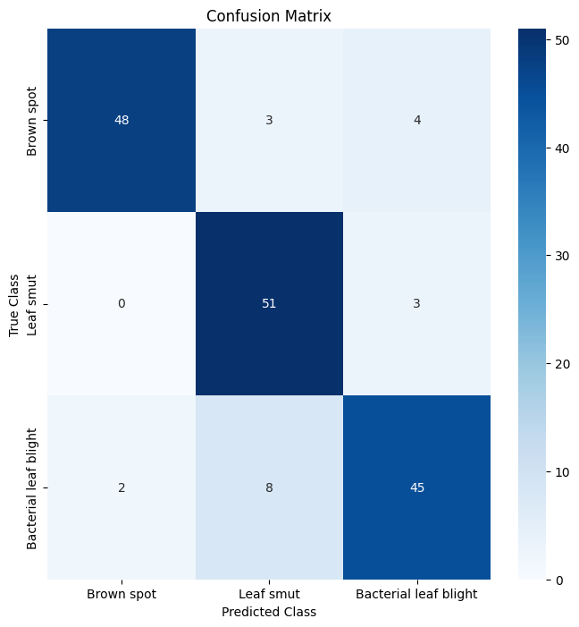
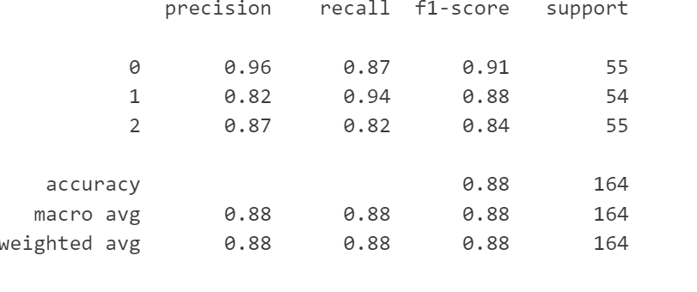
Expected Performance Metrics – testing

Slide 52
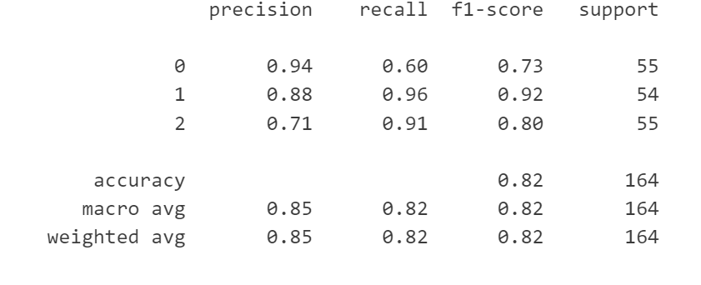
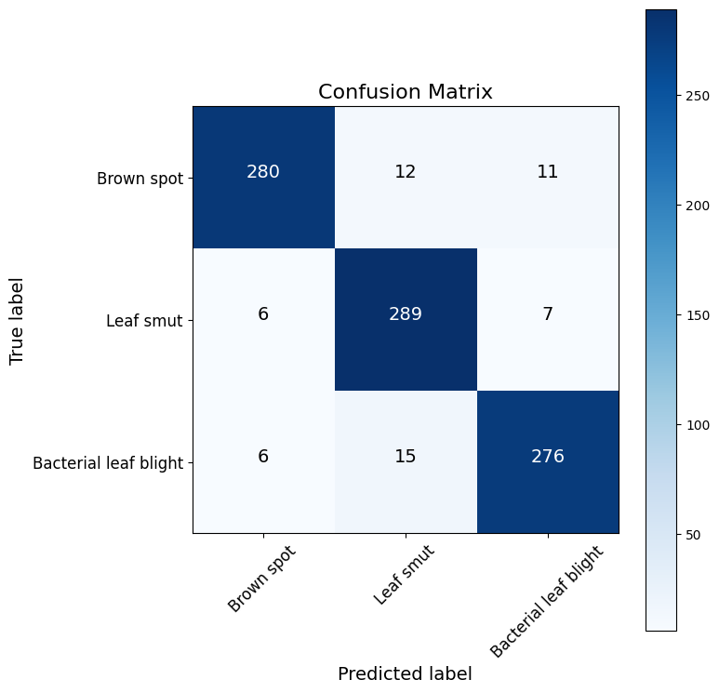
Expected Performance Metrics – training

Slide 53
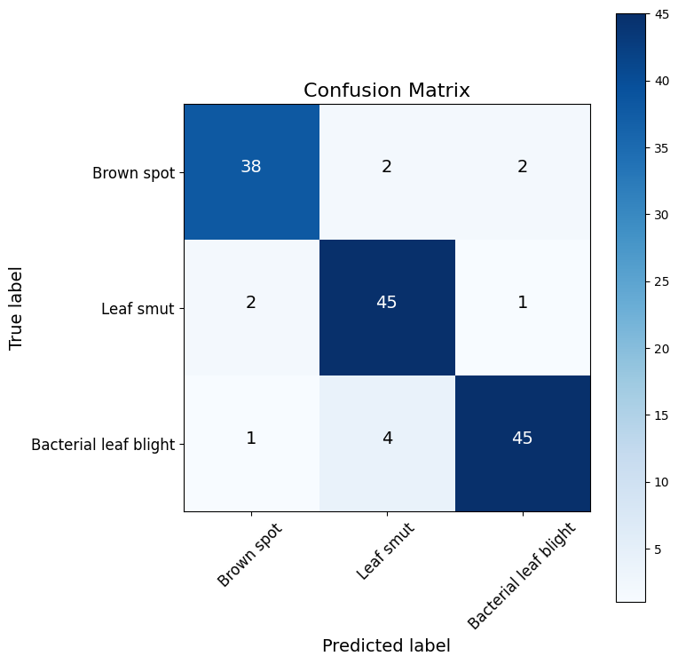
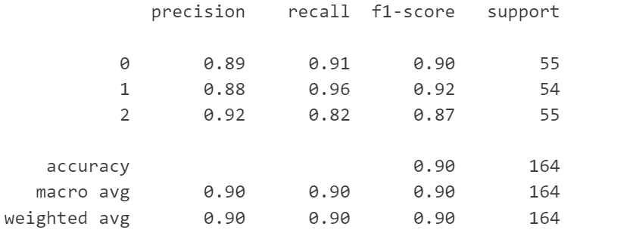
Expected Performance Metrics – validation

Slide 54
Formula for Performance Metrics
Formulas
Metric | Formula
Accuracy | Accuracy=TP+TN/TP+TN+FP+FN ​
Precision | Precision=TP/TP+FP
Recall (Sensitivity) | Recall=TP/TP+FN
F1 Score | F1=2⋅Precision⋅Recall/Precision+Recall​
Specificity | Specificity=TN/TN+FP

Slide 55
Confusion matrix
Actual\Predicted | Positive (1) | Negative (0)
Positive (1) | True Positive (TP) | False Negative (FN)
Negative (0) | False Positive (FP) | True Negative (TN)

Slide 56
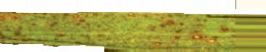
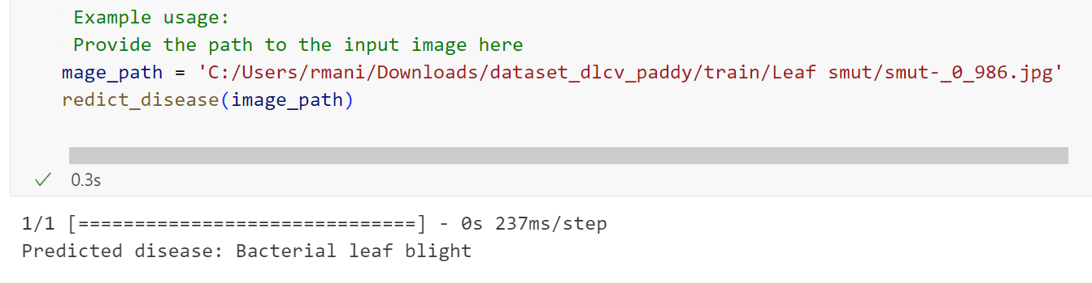
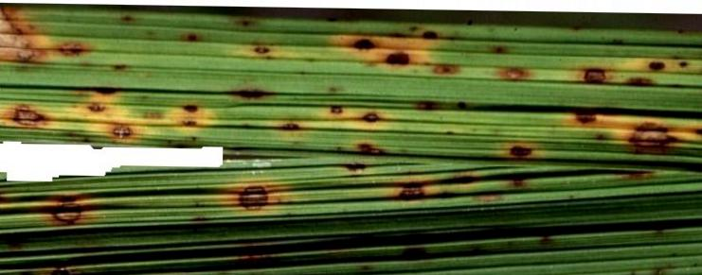
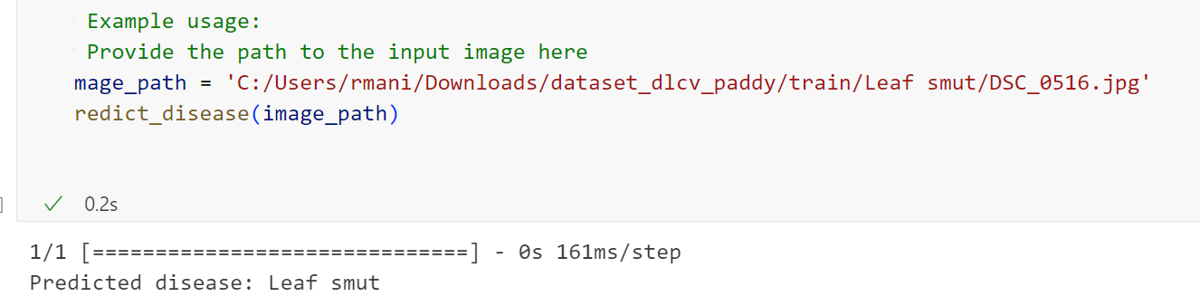
Smut

Slide 57
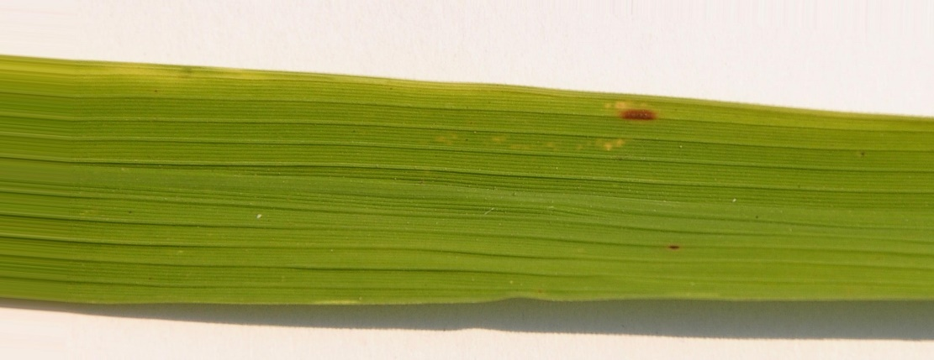
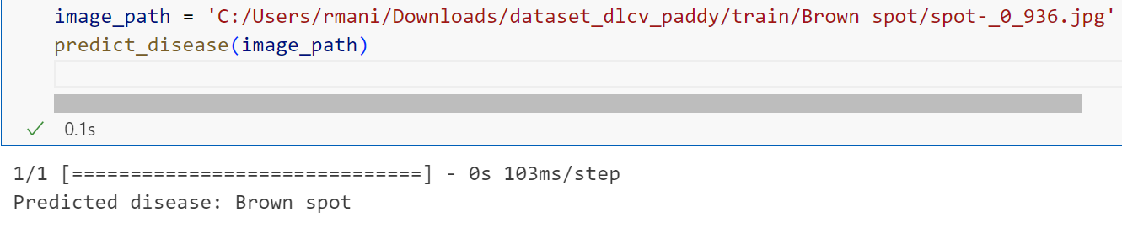
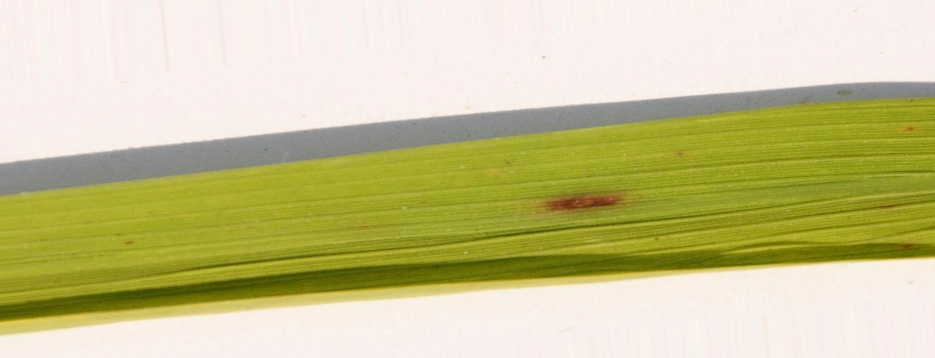
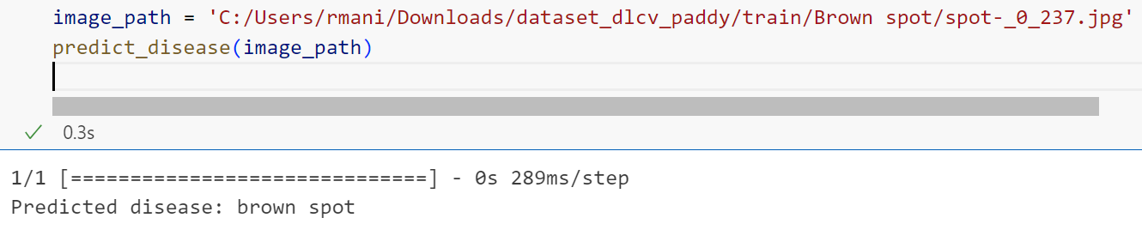
Brown spot

Slide 58
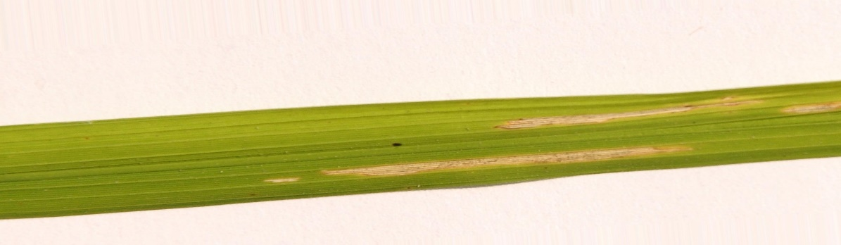
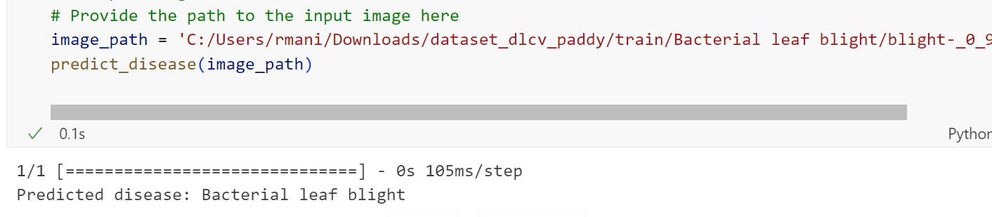
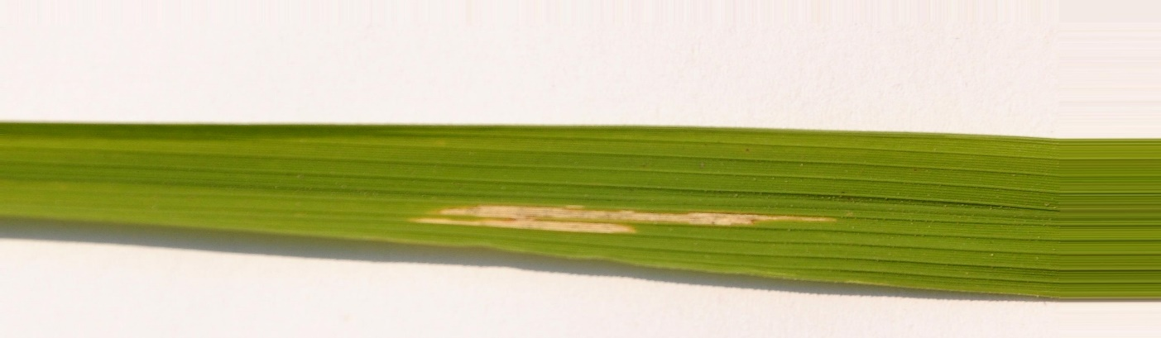
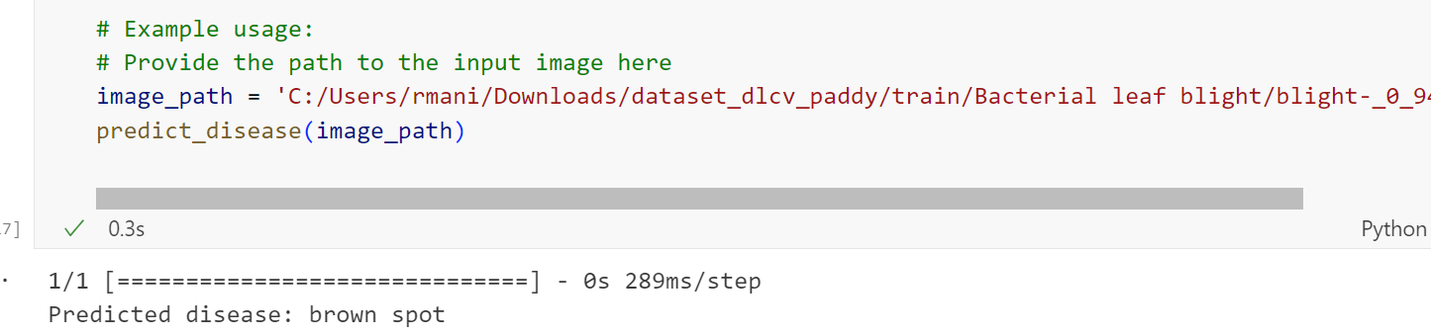
Leaf blight

Slide 59
DLCV
PADDY LEAF DISEASE
DETECTION - PREETHI

Slide 60
INTRODUCTION:
What is Computer Vision?
Computer Vision (CV) is a field of artificial intelligence (AI) that enables computers to interpret and understand visual information from the world, such as images and videos. It involves techniques for image processing, object recognition, and pattern detection, allowing machines to make decisions based on visual inputs. Applications range from facial recognition to autonomous vehicles.
What is Deep Learning in Computer Vision?
Deep learning in CV refers to using neural networks, particularly convolutional neural networks (CNNs), to analyze and interpret complex patterns in visual data. Unlike traditional image processing methods, deep learning automatically learns features from raw data. It’s commonly used in object detection, image classification, segmentation, and more.
Why Deep Learning is Needed for Computer Vision?
Deep learning allows CV systems to solve complex problems that traditional algorithms struggle with, like:
High Dimensionality: Handling massive datasets with millions of pixels and features.
Feature Extraction: Automatically learning complex patterns instead of manually defining them.
Generalization: Deep learning models generalize well across various tasks, such as recognizing objects under different lighting, angles, and scales.

Slide 61
Literature Survey & Findings
Convolutional Neural Networks (CNNs) for Disease Detection
Findings: CNNs are the most popular architecture for detecting plant diseases, achieving high accuracy when trained on large datasets.
Transfer Learning for Agricultural Disease Detection
Findings: Transfer learning helps in achieving good results with small datasets by utilizing pre-trained models like VGG16, ResNet.
Hybrid Architectures Combining CNN and RNN for Sequential Data
Findings: Hybrid models combining CNN for image feature extraction and RNN for temporal data provide better context-awareness in agricultural disease detection.

Slide 62
Features of Deep Learning Architecture Chosen
Feature extraction capability: Automatically detects features such as spots or discoloration on leaves.
Translation invariance: Can detect patterns across varying image conditions.
Efficiency: CNNs are well-suited for image classification tasks.
Computer Vision Approach for CNN Architecture:
CNNs leverage image processing techniques like convolutional layers, pooling, and fully connected layers to detect diseases in paddy images.
References: The CNN-based approach is discussed in detail in several academic studies highlighting its applicability in agriculture.

Slide 63
Some points about Inception:
Inception Module:
The core idea is to use multiple convolutional filters (1x1, 3x3, 5x5) at the same layer, allowing the model to extract features at multiple scales.
These filters are applied in parallel, capturing both fine and coarse details simultaneously.
1x1 Convolutions for Dimensionality Reduction:
The Inception architecture uses 1x1 convolutions to reduce the number of input channels before applying larger convolutions. This helps to reduce computational cost while retaining important information.
It serves as a bottleneck to reduce the computational overhead of applying large filters like 3x3 and 5x5.
Parallel Pathways:
In a single Inception module, different filter sizes (e.g., 1x1, 3x3, 5x5) and pooling operations are applied in parallel. The outputs from these different layers are concatenated, resulting in richer feature extraction.
This concept of parallelism allows the network to learn both local and global features from an image.
Deeper Network with Fewer Parameters:
Inception networks are much deeper than earlier architectures like AlexNet, but they manage to have fewer parameters because of the use of 1x1 convolutions and other optimization strategies.
This helps reduce overfitting while maintaining a high capacity to learn complex patterns.

Slide 64
Methodology/Approach
Steps with Algorithm:
Input Image: Paddy field images are pre-processed.
Convolution Layer: Applies filters to extract features.
Pooling Layer: Reduces dimensionality while preserving important information.
Flattening: Converts the 2D matrix data to 1D.
Fully Connected Layers: Final classification layer predicts the disease class.
Output: The network predicts whether the paddy is healthy or diseased.

Slide 65
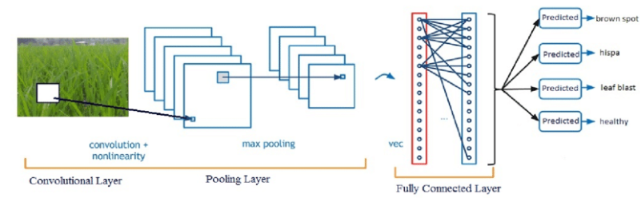
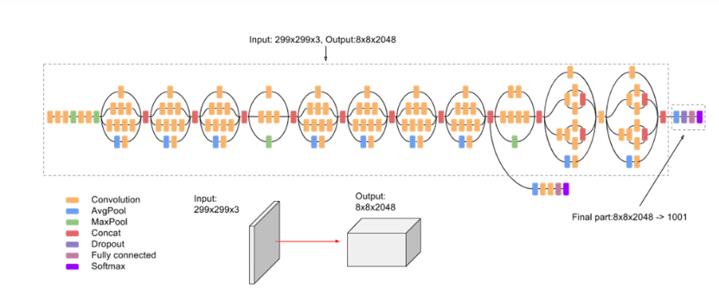

Slide 66
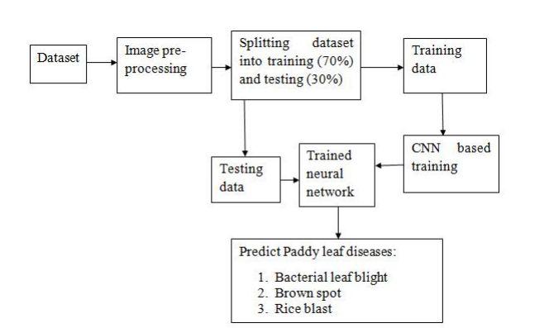
Block diagram:

Slide 67
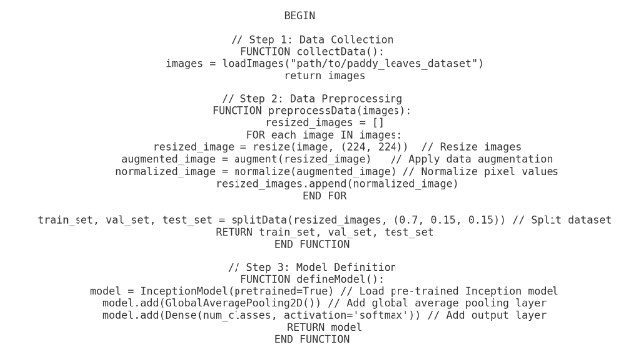
Algorithm:

Slide 68
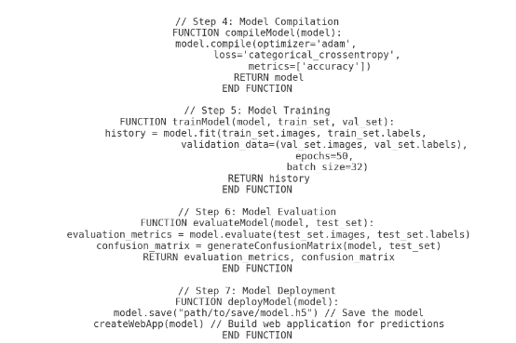

Slide 69
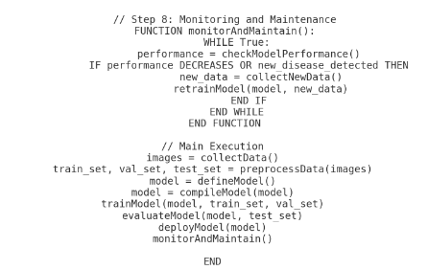

Slide 70
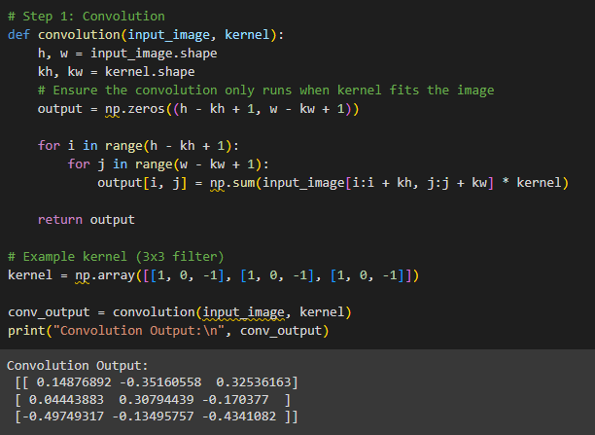
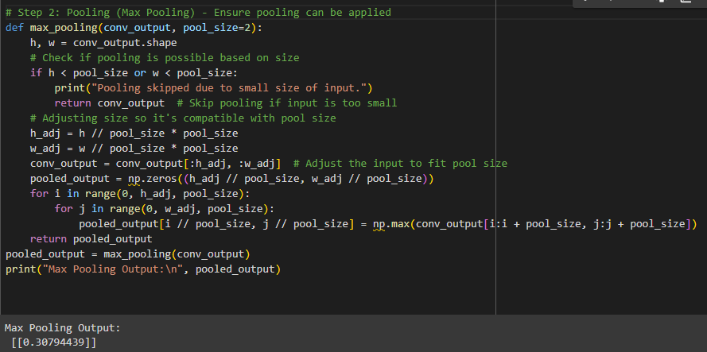

Slide 71
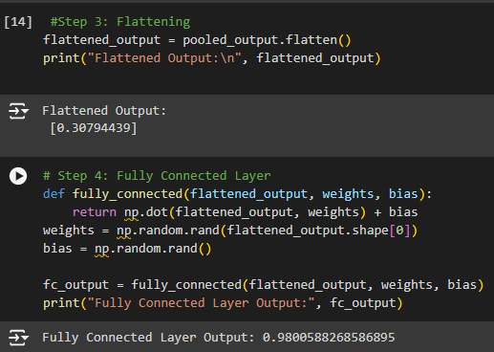
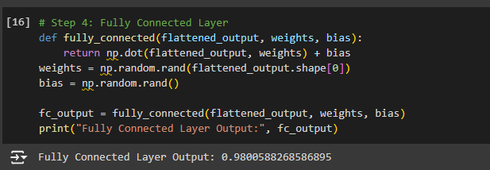

Slide 72
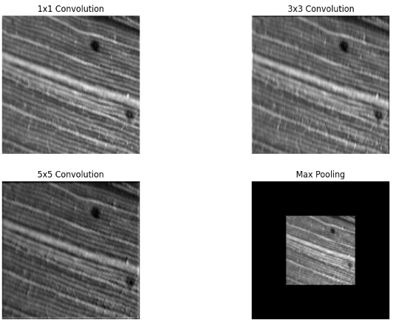
Leaf smut:

Slide 73
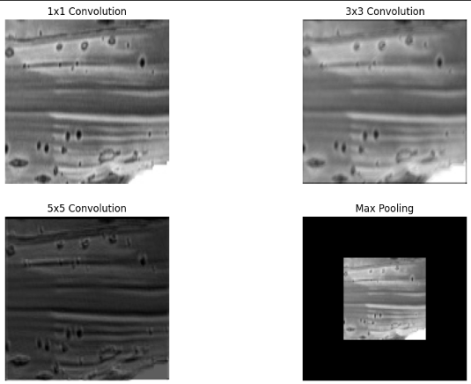
Brown spot:

Slide 74
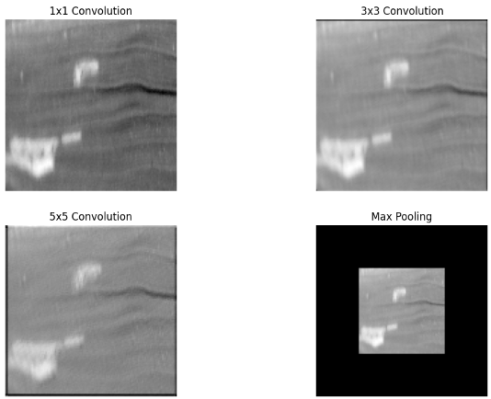
Leaf blight:

Slide 75
Why This Architecture for This Dataset/Problem?
Accuracy: CNNs achieve high accuracy in image classification tasks.
Automation of Feature Extraction: Unlike traditional methods, CNNs automatically extract relevant features like spots and patterns.
Scalability: CNNs can be trained on large datasets, making them suitable for agricultural image classification.
Robustness: Handles noise and variations in real-world images (e.g., different lighting conditions in the paddy fields).

Slide 76
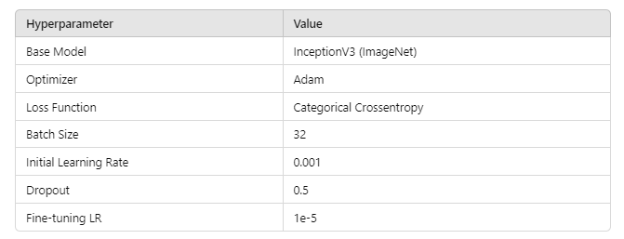
Hyperparameter Table

Slide 77
Hyperparameter Tuning
Learning Rate Tuning: Experimenting with lower learning rates for more precise weight updates.
Batch Size Tuning: Testing different batch sizes to optimize model training time and performance.
Dropout Rate: Adjusting to prevent overfitting.
Set Up Planned
Performance Metrics:
Accuracy: The percentage of correctly classified images.
Precision, Recall, and F1-score: To evaluate model performance on imbalanced data.
Confusion Matrix: To analyze false positives and negatives.

Slide 78
Benefits of Inception for Paddy Leaf Disease Detection:
Multi-scale feature extraction: Helps capture the varying sizes of disease spots on leaves.
Efficient memory use: Makes the model more practical to run on standard GPUs.
High accuracy: Can achieve better accuracy due to capturing diverse features without overfitting.

Slide 79
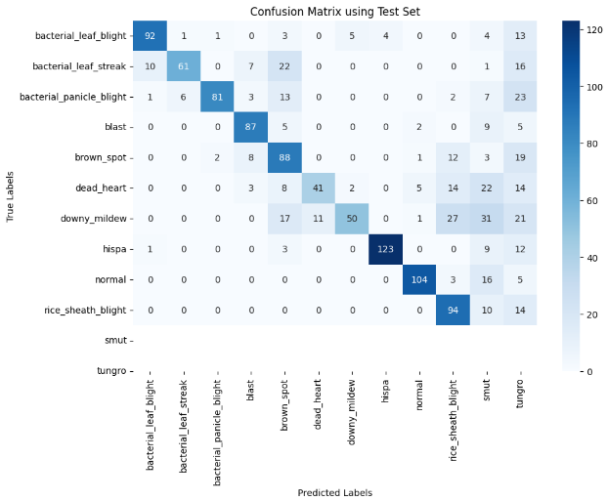
Confusion Matrix:

Slide 80
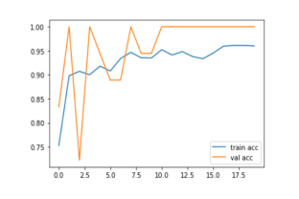
Graph: Train-Val accuracy

Slide 81
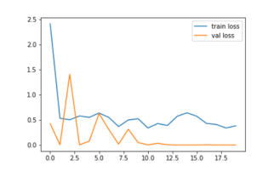
Graph: Train-Val Loss

Slide 82
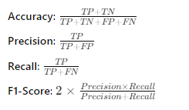
Formula for Performance Metrics

Slide 83
Research Questions:
1.How can ensemble learning techniques (combining multiple models) improve the accuracy and robustness of paddy disease detection?
Model Diversity:
The truth is that different models capture different features in data. With many models, the changed chances include avoided overfitting and more general results. Boosting and Bagging:
Methods like Random Forest is of bagging, and XG Boost of boosting improve prediction by aggregation of several weaker models and error correction. Voting Ensembles:
Simple majority voting or weighted voting from multiple classifiers can boost up the level of accuracy, as individual models may respond in different ways at various parts of the dataset. Robustness:
Ensemble methods are less sensitive to noise and outliers within the dataset, and this improves the stability of paddy disease detection models.

Slide 84
2.How can real-time paddy disease detection systems be optimized for large-scale deployment in the field, considering factors like processing power and latency?
Edge Computing Lightweight models can be deployed on edge devices such as drones or smartphones to minimize data transmission time and latency Techniques, such as quantization and pruning, further aid in model size and complexity reduction, which in turn may contribute to making models more efficient for limited processing power devices. GPU/TPU Acceleration:
Hardware accelerators might be applied to speed up processing, thereby reducing the time for real-time predictions. Pipeline Optimization:
Even in real-world deployments, the optimized inference times may be achieved with data pipelines and will ensure the real-time decision using tools like TensorFlow Lite or ONNX. Scalability:
A blend of cloud-based architecture with local processing facilitates scale deployment required through balancing between local processing and cloud processing, which happens to be the batch analysis.

Slide 85
3.What is the role of image segmentation in improving the detection of paddy diseases, and how can it be effectively integrated with deep learning models?
Focus on Disease Regions:
Segmentation identifies specific areas of the leaf that can be seen to have disease symptoms, allowing the models to focus on those areas instead of having to look throughout the whole image, thus improving the detection accuracy.
Integration with Deep Learning:
It can be added to CNN or UNet architectures to build a pipeline wherein images are first segmented, and then passed into a classifier for disease detection.
Improved Localization:
This further helps the models in localization of the disease symptoms correctly when the diseases impact the specific regions of the leaf.

Slide 86
4.How does environmental variability (such as changes in lighting, background, or weather conditions) affect the performance of deep learning models in detecting paddy diseases in real-world settings?
Lighting Changes:
Training with ideal lighting images may make the model fail under low or over-exposed lighting conditions. Brightness adjustment coupled with adaptive histogram equalization can be applied to augment data in the sense of making it resistant to variation due to lighting conditions.
Background and Noise:
As it is observed, models can be misguided by the varied background conditions including soil and water. Applying image preprocessing techniques, for instance, background subtraction coupled with segmentation may significantly reduce interference from background information irrelevant.
Weather Conditions:
Environment, including fog, rain, or glare conditions, introduces distortions to images. Appropriate normalization of images as well as training on a broader dataset, that contains images even in different weather conditions, will make the models robust for such scenarios.

Slide 87
5.To what extent does the size and diversity of the training dataset influence the accuracy of paddy disease detection using deep learning?
More Data Helps a Lot:
The more data the model has, the better are its generalizations, less overfitting on particular cases. A higher number of examples of each disease makes the model learn better about the subtleties of each class.
Diverse Data:
A wide variety of data inclusion-including various illuminations, angles, and various stages of disease progression-ensure that the model works well in various real-world conditions and not only in controlled conditions.
Data Augmentation:
If it is hard to get an extremely large data set, data augmentation techniques like rotation, zooming, and flipping artificially boost the dataset and also increase the model's robustness.

Slide 88


Slide 89


Slide 90
Authors | Title | Study Purpose | Method | Key Findings | Limitations | Research Gaps
D Hemanth Kumar, Samundiswary Punniakodi | Rice Leaf Disease Detection Using ResNet50. | To develop and evaluate a Rice Leaf Disease Detection (RLDD) system using ResNet50 architecture to accurately classify four types of rice leaf diseases. | - Used ResNet50 convolutional neural network architecture Dataset: 5932 images of rice leaves with 4 disease classes (Bacterial Blight, Blast, Brown Spot, Tungro)Data split: 75% training, 15% testing, 10% validation,Preprocessing: image resizing, color channel conversion, normalization,Training specifications: 25 epochs, learning rate 0.0001, Adam optimizer, Softmax activation. | - Achieved 100% accuracy, precision, recall and F1-score for all 4 disease classes Outperformed existing methods that only detected blast disease Successfully classified 4 disease types compared to previous work focusing on single disease. | - Only tested on 4 disease classes(Relatively small dataset size)Not tested in real-world field conditions. | - Need for larger, more diverse datasets covering more disease types Lack of real-time field testing and mobile application integration Limited exploration of model interpretability and explainability Need for adaptation to different environmental conditions and rice varieties

Slide 91


Slide 92
Computer Vision Based Approach
Approach: Uses residual learning with skip connections to enable training of very deep networks by mitigating vanishing gradient problems. Focuses on learning residual mappings which are easier to optimize.
Key Feature: Skip connections between layers allow gradients to bypass intermediate layers, aiding deep training.
Strength: Performs exceptionally well in classification tasks, reduces degradation in very deep networks.

Slide 93
Methodology
The methodology diagram in Figure 1 shows the flow of the paddy leaf disease detection system. It includes data collection, preprocessing (median filtering and contrast enhancement), segmentation using Adaptive K-means Clustering, and classification using a hybrid ResNet-YOLO model optimized by Fitness Sorted-Shark Smell Optimization (FS-SSO).

Slide 94


Slide 95
Algorithm
The FS-SSO algorithm is designed to optimize parameters within the hybrid ResNet-YOLO classifier. The algorithm begins by identifying odor particles, which represent the positions of potential solutions, and updates these positions based on fitness values. It alternates between forward and rotational movements to converge on the optimal solution.

Slide 96
Why This Architecture?
ResNet is chosen due to its deep structure, ability to handle vanishing gradients with skip connections, and robust feature extraction capability.
YOLO (You Only Look Once) is integrated for its real-time object detection capabilities, which help in classifying diseased regions with high speed and accuracy. The combination of ResNet's feature extraction and YOLO's detection enhances overall disease recognition accuracy.

Slide 97
Hyperparameter Table
Hyperparameter | ResNet | YOLO
Learning Rate | Optimized by FS-SSO | Optimized by FS-SSO
Number of Hidden Neurons | Tuned for each layer | Tuned for each layer
Batch Size | Specific per dataset | Specific per dataset
Epochs | Fixed per training | Fixed per training

Slide 98
Hyperparameter Tuning
The hyperparameters, including the number of hidden neurons and learning rates, are tuned using the FS-SSO algorithm, which optimizes the ResNet and YOLO architectures for improved classification and reduced overfitting. The FS-SSO dynamically adjusts these parameters during training to enhance the model's performance.

Slide 99
Formula for the Performance Metrics Planned on the Project
Accuracy: Accuracy = Yp + Yn / Yp + Yn + Xp + Xn
Precision: Precision = Yp / (Yp + Xp)
Sensitivity: Sensitivity = Yp / (Yp + Xn)
F1-Score: F1-Score = 2 x Yp / (2 x Yp + Xp + Xn)
Specificity: Specificity = Yn / (Yn + Xp)
False Positive Rate (FPR): FPR = Xp / (Xp + Yn)
False Negative Rate (FNR): FNR = Xn / (Xn + Yp)

Slide 100
Explainable AI
Algorithm Name | Student contributed
shap | Daranesh
Grad-cam (VGG) | Keerthana
Grad-cam(Inception) | Preethi
Explain the architecture chosen and discuss how interpretation can be done.

Slide 101
Architecture and Interpretation for Grad-CAM with VGG in Paddy Disease Classification
Architecture Chosen:
VGG Model: Utilizes VGG-16 architectures, known for their deep convolutional layers which effectively capture spatial hierarchies in images.
Grad-CAM (Gradient-weighted Class Activation Mapping): This technique visualizes the regions of the input image that are most influential in the model's decision-making process.
Enhances model transparency by providing insights into decision-making.

Slide 102
Architecture and Interpretation for Grad-CAM with Inception in Paddy Disease Classification
Grad-CAM is applied to the Inception model to visualize which areas of the input image were most influential in the classification. It is particularly useful to ensure the model’s attention is on the diseased part of the leaf rather than on irrelevant background regions.
Gradient Computation: Grad-CAM works by computing the gradients of the predicted class score with respect to the feature maps of the last convolutional layer (usually the layer before the dense layers). The gradients indicate how much a change in each pixel of the feature map affects the final prediction.
Weighted Feature Maps: Grad-CAM takes a weighted average of these gradients to determine which parts of the feature map are most significant for the model's prediction. The weights correspond to the importance of each feature map channel for the given class.
Heatmap Generation: The weighted feature map is then upsampled to the original input image size and visualized as a heatmap, with warm colors (e.g., red) indicating areas of high relevance and cooler colors (e.g., blue) indicating areas of low relevance.
Overlay on Original Image: This heatmap is overlaid on the original paddy leaf image to provide an intuitive visual explanation of where the model "looked" when classifying the image. This helps verify that the model is focusing on disease-affected areas rather than unrelated regions.

Slide 103
PADDY DISEASE DETECTION
SL.NO | NAME | ROLL NUMBER
1 | Darneshwar S | CB.EN.U4CSE21309
2 | S Keerthana | CB.EN.U4CSE21349
3 | Preethi V | CB.EN.U4CSE21365
Subject code : 19CSE437
Subject Name : Deep Learning for Computer vision
Review-3

Slide 104
21309
Overall Architecture Diagram
Existing Product features
Module Diagram
Explanation of Modules
Technology Stack
UI wireframe designs --- For each module
Working of the product

Slide 105

Block diagram

Slide 106

Xception Architecture
21309
CSE21309

Slide 107
Algorithm
Data Collection:
Gather a dataset of images of paddy plants, ensuring to label them according to the disease or healthy status.
Organize the dataset into training, validation, and test sets.
Data Preprocessing:
Image Resizing: Resize all images to a uniform size (e.g., 224x224 pixels).
Normalization: Scale pixel values to the range [0, 1] by dividing by 255.
Data Augmentation (optional): Apply techniques like rotation, flipping, and zooming to increase the dataset size and variability.
Model Initialization:
Load the Xception model, pre-trained on ImageNet.
Modify the model architecture:
Remove the top (classification) layer.
Add a global average pooling layer followed by a dense layer with a softmax activation function for multi-class classification (or a sigmoid for binary classification).

Slide 108
Compile the Model:
Choose an optimizer (e.g., Adam) and set the learning rate.
Specify the loss function (e.g., categorical cross-entropy for multi-class or binary cross-entropy for binary classification).
Define evaluation metrics (e.g., accuracy, precision, recall).
Training:
Train the model using the training dataset.
Validate the model using the validation dataset.
Monitor the training process using callbacks (like EarlyStopping and ModelCheckpoint) to save the best model.
Evaluation:
Evaluate the model on the test dataset.
Calculate performance metrics such as accuracy, precision, recall, and F1-score.

Slide 109
Existing Product Features
Image Upload Module:
Feature: Allows users to upload an image for classification.
Implementation: The st.file_uploader function is used to enable file uploads. Once the image is uploaded, it is displayed on the interface using st.image.
Model Loading Module:
Feature: Loads the pre-trained Xception model for image classification
Implementation: The model is loaded using the load_model function from TensorFlow, which retrieves the model saved in a .h5 format. It ensures efficient reuse of the model through st.cache to avoid reloading on every interaction.

Slide 110
Image Preprocessing Module:
Feature: Prepares the uploaded image for input into the Xception model.
Implementation: The image is resized to the Xception model's required input size (299x299), normalized, and expanded to match the model’s input dimensions.
Prediction Module:
Feature: Performs the classification by passing the preprocessed image through the Xception model.
Implementation: The image is fed into the Xception model using model.predict(). The prediction result is a probability distribution across classes, which is processed to return the highest confidence class.

Slide 111
Result Display Module:
Feature: Displays the classification result (disease name or object class) and the associated confidence score.
Implementation: TResult Display Module:he classification result is formatted and displayed using st.write, showing the predicted class and the confidence value.
Image and Accuracy Display Module:
Feature: Displays the uploaded image along with the model's prediction and confidence.
Implementation: After prediction, both the uploaded image and the prediction result are shown side by side. The image is rendered using st.image, and the accuracy (confidence score) is displayed below it.

Slide 112
Model Accuracy Display Module:
Feature: Shows the overall model accuracy based on its performance on the test set.
Implementation: After prediction, a pre-calculated accuracy metric (saved during training) is displayed alongside the image and classification result using st.write.

Slide 113

Module Diagram

Slide 114
Streamlit Frontend
Purpose: This is the user interface layer where the user interacts with the application. It handles how users upload images, trigger actions, and view the results.
Components:
Image Upload: Provides an interface for users to upload an image that will be used for classification.
Buttons: The interface includes a button that users can click to start the prediction process (e.g., "Predict").
Text Display: Displays information like instructions, prediction results, and accuracy scores. This module ensures that users can see the output of their actions in a readable format.
Image Preprocessing
Purpose: This module prepares the uploaded image so that it can be correctly analyzed by the Xception model. The preprocessing steps ensure that the image matches the input requirements of the model.
Process:
Resizing: Adjusts the size of the uploaded image to the input size expected by the Xception model.
Normalization: Scales pixel values to a range suitable for the model’s input, ensuring consistency across different images.
Channel Adjustment: If necessary, adjusts the image format (e.g., converting grayscale to RGB) to match the model’s requirements.

Slide 115
Model Loading
Purpose: This module is responsible for loading the pre-trained Xception model into memory so that it can be used for making predictions.
Process:
The pre-trained model is loaded from storage and remains in memory while the app is running, so it doesn’t need to be reloaded with every prediction.
This module optimizes the app’s performance by caching the model, ensuring faster predictions.
Prediction Module
Purpose: This module is where the actual classification takes place. It uses the preprocessed image to make a prediction based on the Xception model.
Process:
The preprocessed image is passed to the loaded model, which then performs the classification.
The model outputs a set of probabilities corresponding to different classes. The class with the highest probability is considered the predicted class.

Slide 116
Display Results
Components:
Display Uploaded Image: This component displays the image uploaded by the user so they can visually confirm which image is being classified.
Display Prediction Results (Class & Accuracy): This component shows the predicted class and its associated confidence score. The result is displayed in an easy-to-read format, giving feedback to the user on the model’s prediction accuracy.

Slide 117
Technology Stack
Frontend: Streamlit
Streamlit is a Python framework used to build interactive web applications. It allows you to easily create user interfaces (like image upload buttons and result displays) without needing extensive frontend coding (like HTML, CSS, or JavaScript).
It’s simple and effective for building data-driven apps and displaying real-time results to users. Streamlit handles the user interface and makes the app interactive by allowing users to upload images, trigger predictions, and see results.
Backend: Python & TensorFlow
The core of your app runs on Python, where you use the TensorFlow framework to load the Xception model, preprocess the images, and make predictions.
Python is widely used in machine learning and data science because of its simplicity and rich ecosystem of libraries. TensorFlow is a powerful tool for working with machine learning models, and the Xception model is a deep learning architecture that's particularly effective for image classification.

Slide 118
Machine Learning Model: Xception
Xception is a pre-trained neural network model specialized for image classification tasks. When a user uploads an image, this model analyzes it and makes predictions about which class (category) the image belongs to.
Pre-trained models like Xception are efficient because they’re already trained on large datasets (e.g., ImageNet), which means you can use them directly or fine-tune them for your specific task without having to build a model from scratch.
Image Processing: PIL and NumPy
Before passing the uploaded image to the model, it needs to be resized and normalized. The Pillow (PIL) library helps with image processing, such as resizing and format conversion. NumPy is used to handle the image data in the form of arrays and perform mathematical operations, such as normalization.
PIL and NumPy are widely used libraries for image manipulation and efficient handling of large datasets in machine learning workflows.

Slide 119
Environment Management: Virtual Environments
You use virtual environments (like myenv and the training environment) to keep your project’s dependencies (like TensorFlow) separate and ensure compatibility between different versions of software.
Managing environments helps avoid conflicts between different package versions (e.g., TensorFlow 2.15.0 in one environment vs. 2.17.0 in another), making sure your app runs smoothly without version-related issues.

Slide 120


Wireframe Designs
First, The Web-app is installed in a virtual environment that has been within in a file.
Then using the command streamlit run app.py, the following streamlit code opens the web browser
You can see that, the streamlit app provides the Local URL for the webpage to be opened

Slide 121


The Final Output!
This is the First part of the output where the UI is displayed, Which asks for the image as the Input. So once the image is given an input, the following will display the output

Slide 122

This is the Second part of the output, where you can see that predict button is given.
Once you click the button, the following input image is driven into the model and the classification happens.
I have designed the code to classify based on classes of images. So class A is called Bacterial Leaf Blight.

Slide 123
UI Wireframe Designs
Module | Wireframe design Name | Student Associated(RollNo,Name)
image uploads and displaying results | UserInterface | Darneshwar S (CB.EN.U4CSE21309)
Preprocesses images for analysis | ImageProcessing | Darneshwar S(CB.EN.U4CSE21309)
Implements deep learning models to classify paddy diseases. | DiseaseClassification | Darneshwar S (CB.EN.U4CSE21309)
Manages user data, uploaded images, and logs of disease detection results. | Database management | Darneshwar S(CB.EN.U4CSE21309)

Slide 124
Working of the product
User Interface Initialization:
When the user accesses the app, the Streamlit interface is initialized. This includes the title and any introductory text that describes the purpose of the application.
Image Upload:
Feature: Users can upload an image of paddy plants to classify potential diseases.
Implementation: The st.file_uploader function creates a file upload button on the interface. Users can select an image file (e.g., JPG or PNG) from their local machine. Once uploaded, the app uses st.image to display the image on the screen.

Slide 125
Model Loading:
Feature: The app loads the pre-trained Xception model, which has been trained on a dataset of paddy diseases.
Implementation: The model is loaded using load_model from TensorFlow. To enhance performance and minimize loading time, the model loading process is cached with st.cache, ensuring the model is loaded only once during the app session.
Image Preprocessing:
Feature: The uploaded image needs to be preprocessed to match the input requirements of the Xception model.
Implementation: The uploaded image is resized to the model's input size (299x299 pixels). It is then normalized (typically scaled to a range of 0 to 1) and expanded in dimensions to fit the expected input shape for the model (usually a batch size is added). This is essential for the model to interpret the input correctly.

Slide 126
Prediction:
Feature: The preprocessed image is classified using the Xception model.
Implementation: The app calls model.predict() on the preprocessed image. The model returns a probability distribution across the different disease classes. The app then processes this output to determine the class with the highest confidence score, identifying the predicted disease.
Result Display:
Feature: The classification result is presented to the user.
Implementation: The app formats and displays the prediction result using st.write, showing the predicted disease name (or object class) along with the associated confidence score

Slide 127
Image and Confidence Display:
Feature: The uploaded image is shown alongside the prediction result and confidence score.
Implementation: The app renders the uploaded image again using st.image, and the prediction result, including the confidence score, is displayed directly below the image. This provides a clear and concise view of the output.
Model Accuracy Display:
Feature: The overall accuracy of the model based on its training and validation performance is presented.
Implementation: The app displays a pre-calculated accuracy metric using st.write.
CSE21309

Slide 128


Explainable AI
Visual Annotation Method: The approach focuses on annotating images based on model predictions, providing a straightforward visual interpretation of the model's output. It highlights areas in the image that the model deems significant, showing what it predicts for each area
Input Image
Output

Slide 130
Agenda
Overall Architecture Diagram
Existing Product features
Module Diagram
Explanation of Modules
Technology Stack
UI wireframe designs --- For each module
Working of the product
21349

Slide 131

VGG Architecture Diagram

Slide 132

Environment setup for FLASK
Image source : Keerthana_VGG_poster.pptx

Slide 133

Input : Upload the image from local computer
Image source : Keerthana_VGG_poster.pptx

Slide 134

Model processing in Background
Image source : Keerthana_VGG_poster.pptx

Slide 135

Final Prediction
Image source : Keerthana_VGG_poster.pptx​

Slide 136
Module Diagram -
Contribution : Keerthana CB.EN.U4CSE21349
User Interface Module
Disease Detection Module
Image Upload Module
PADDY DISEASE CLASSIFICATION APP
Database Management Module
Image Preprocessing Module
Evaluation module

Slide 137
Explanation of Modules
Contribution : Keerthana CB.EN.U4CSE21349​
1. Image Upload and Displaying Results
Users can easily upload images of paddy leaves.
Uploaded images are displayed immediately for user confirmation.
Supports multiple image formats (e.g., JPG, PNG).
2. Image Preprocessing for Analysis
Images are resized and normalized to fit model requirements.
Data augmentation techniques may be applied to enhance model robustness.
Ensures high-quality input for accurate disease classification.
3. Deep Learning Model Implementation
Utilizes pre-trained models (e.g., CNNs) for disease classification.
Models are trained on a diverse dataset of paddy diseases.
Outputs include detected diseases with confidence scores.
4. Result Presentation
Displays detected diseases along with descriptions and treatment recommendations.
Provides a user-friendly interface for easy navigation and understanding.
Option for users to provide feedback on prediction accuracy.

Slide 138
Technology Stack of the product
Contribution : Keerthana CB.EN.U4CSE21349​
1. Backend Framework
Flask
2. Machine Learning Libraries
TensorFlow
Keras
3. Image Processing Libraries
OpenCV
Pillow
4. Database Management​
SQLite​
SQLAlchemy​
5. Frontend Technologies​
HTML​
CSS​
JavaScript​

Slide 139
UI wireframe designs
Module | Wireframe design Name | Student Associated(RollNo,Name)
image uploads and displaying results | UserInterface | S Keerthana (CB.EN.U4CSE21349)
Preprocesses images for analysis | ImageProcessing | S Keerthana (CB.EN.U4CSE21349)
Implements deep learning models to classify paddy diseases. | DiseaseClassification | S Keerthana (CB.EN.U4CSE21349)
Manages user data, uploaded images, and logs of disease detection results. | Database management | S Keerthana (CB.EN.U4CSE21349)

Slide 140
Wireframe Designs for Paddy Disease Classification App
The following wireframe designs illustrate the user journey from input to output within the Paddy Disease Classification application. Each design represents a key interaction point, showcasing how users will engage with the app.
1. Home Screen
Components:
Navigation Bar: Links to Home, Disease Detection
Quick Access Buttons:"Detect Disease"
2. Disease Detection Screen
Components:
Image Upload Section:
Button to upload an image of paddy leaves.
Option to take a photo directly using the camera.
Submit Button: To send the image for analysis.

Slide 141
3. Processing Screen
Components:
Loading Animation: Indicates that the image is being processed.
Message Display: "Analyzing your image, please wait..."
Processing Screen Wireframe
4. Results Display Screen
Components:
Detected Diseases Section:
List of diseases detected with images
5 Interaction Flow
Uploads Image: The user uploads an image of paddy leaves or takes a new photo.
Processes Image : After submission, the processing screen appears, indicating that the image is being analyzed.
Receives Results: Once processing is complete, the results display screen shows detected diseases and recommendations.

Slide 142
Working of the product
Contribution : Keerthana CB.EN.U4CSE21349​
1. User Accesses the Application
The user opens the web application in their browser, which is served by the Flask backend.
2. Image Upload
The user navigates to the Disease Detection section.
They see an interface with an option to upload an image of paddy leaves.
The user clicks on the Upload Image button and selects an image from their device.
3. Image Submission
Upon selecting the image, the user clicks on the Submit(PREDICT) button.
The application captures this action and sends a POST request to the Flask server with the uploaded image.

Slide 143
4. Image Processing
The Flask backend receives the image and passes it to the Image Processing Module.
This module preprocesses the image (e.g., resizing, normalization) to prepare it for analysis.
5. Disease Prediction
The preprocessed image is then forwarded to the Disease Detection Module.
Here, machine learning or deep learning models (e.g., TensorFlow/Keras) analyze the image to classify any diseases present.
The model outputs predictions along with confidence scores for each detected disease.
6. Results Display
The Flask backend formats the prediction results into a JSON response.
Response : Detected diseases
The application sends this response back to the user interface.
Contribution : Keerthana CB.EN.U4CSE21349​

Slide 144
Agenda
CSE21365
Overall Architecture Diagram
Existing Product features
Module Diagram
Explanation of Modules
Technology Stack
UI wireframe designs --- For each module
Working of the product

Slide 145

Inception Architecture Diagram
CSE21365

Slide 146
Existing product features
CSE21365
Image Upload Module:
Feature: Users can upload paddy leaf images using a simple form with file input support for image types (e.g., JPG, PNG). The module also handles basic validation to ensure the correct file format is uploaded.
Implementation: The module uses HTML’s <input type="file"> element and is styled for user-friendly interaction. It includes JavaScript to handle the file selection.
Image Preview Module:
Feature: After uploading, the selected image is immediately previewed on the screen, allowing users to verify the image before submission.
Implementation: A FileReader object is used in JavaScript to render the image for preview in an <img> element, displaying the image directly within the interface without submitting the form.
Disease Detection Module:
Feature: Once the image is uploaded, the system simulates disease detection by randomly selecting a predefined disease (such as Bacterial Leaf Blight, Brown Spot, etc.) and displays an accuracy score for the result.
Implementation: The detection is simulated using an array of possible diseases in JavaScript. Upon submission, the system randomly selects a disease and corresponding accuracy score to display to the user.

Slide 147
Result Display Module:
Feature: The detection result, including the disease name and accuracy score, is presented in a clearly visible section on the page after the detection process is complete.
Implementation: The result is dynamically inserted into HTML elements using JavaScript and is displayed once the detection simulation completes. The result container is hidden by default and is only shown after submission.
Suggested Action Module:
Feature: Based on the detected disease, the system provides relevant suggested actions for disease management, such as pesticide recommendations or preventive measures.
Implementation: Similar to the detection result, the suggested actions are predefined and displayed to the user after the disease detection process. Each disease has corresponding suggestions stored in an array or object in JavaScript.
User Feedback Module:
Feature: Users can give feedback on the detection result and suggested action. They can rate the accuracy of the detection or leave comments on whether the suggested actions were helpful. This feedback can help improve the system's accuracy.
Implementation: A form with input fields (e.g., star ratings, text comments) is displayed after the result and action suggestions are shown. Feedback is stored and can be processed for system improvement.

Slide 148
Module Diagram
CSE21365
Image upload module
Image preview module
Disease detection and result
Suggestion action
User feedback

Slide 149
Explanation of Modules
CSE21365
•Module 1: Image Upload
•A section to upload images, with a button labeled "Upload and Diagnose."
•Allows users to select an image and submit it for disease diagnosis.
•Module 2: Image Preview
•Displays the image preview after image diagnosis, including:
•Disease Name
Module 3: Result
•Confidence Score
Module 4: Suggested action
•Suggested Action for treatment
•Module 5: User Feedback
•A feedback form for users to provide their input after receiving the diagnosis.
•Contains a textarea and a "Submit Feedback" button.

Slide 150
Technology Stack of the product
CSE21365
Image Upload Module:
Frontend:
HTML5 for the form structure.
CSS for styling and user-friendly layout.
JavaScript for handling file input and event management.
Backend:
Flask or Django (Python frameworks) to handle image uploads.
Cloud Storage: AWS S3, Google Cloud Storage, or Azure Blob Storage for storing the uploaded images.
Image Preview Module:
Frontend:
JavaScript with FileReader API to preview the uploaded image before submission.
CSS for styling the image display area.
Backend: No backend required specifically for this part as it's handled on the client-side.

Slide 151
Disease Detection Module:
Backend:
Python for developing the disease detection logic.
OpenCV or TensorFlow/Keras for computer vision-based image analysis and deep learning.
Pre-trained Models or custom-trained models for detecting specific diseases.
REST API (Flask/Django) to handle the image submission and return disease detection results.
Database: A database like MongoDB or PostgreSQL to store disease types and results.
Result Display Module:
Frontend:
JavaScript or React.js for dynamically displaying detection results (disease and accuracy).
Backend:
The disease detection result fetched via API and displayed to the user.

Slide 152
Suggested Action Module:
Backend:
Python backend with a predefined list of disease-specific suggestions stored in a database (PostgreSQL, MongoDB).
API to fetch disease-specific recommended actions and display them to the user.
Frontend:
JavaScript or React.js to display the suggestions alongside the detection result.
CSS for formatting the suggestions section.
User Feedback Module:
Frontend:
HTML/CSS for the feedback form (ratings and comments).
JavaScript to capture and submit feedback.
Backend:
Flask/Django to handle feedback submission and store the feedback in a database.
Database: Use MySQL or MongoDB to store user feedback for further analysis.
Analytics Tools: Use tools like Google Analytics or custom Python scripts for analyzing feedback trends and improving the detection algorithm.

Slide 153
UI wireframe designs
Module | Wireframe design Name | Student Associated(RollNo,Name)
Image Upload | Image upload interface | CB.EN.U4CSE21365
Image Preview | Image confirmation preview | CB.EN.U4CSE21365
Disease Detection and Result | Disease detection process Detection results Display | CB.EN.U4CSE21365
Suggested action | Additional information & recommendation | CB.EN.U4CSE21365
User feedback | User interaction feedback | CB.EN.U4CSE21365

Slide 154





Wireframe designs
CSE21365

Slide 155
Explanation of wireframe designs:
CSE21365
Image Upload Module: Allows users to upload paddy leaf images for disease detection via a form. It also provides a preview of the uploaded image.
Image Preview Module: Displays a preview of the image chosen by the user, allowing them to verify it before submitting.
Disease Detection Module: Simulates the detection of paddy leaf diseases by using predefined disease types with accuracy scores, showing the result to the user.

Slide 156
Result Display Module: Shows the detected disease and the corresponding accuracy score once the image has been analyzed.
Suggested Action Module: Provides recommended actions based on the detected disease. For example, it suggests appropriate treatments such as the use of pesticides or preventive agricultural practices to manage the disease.
User Feedback Module: Allows users to provide feedback on the detection result and the suggested action. Users can rate the accuracy of the detection and give comments, helping improve the model's effectiveness.

Slide 157
Working of the product
CSE21365
Step 1: User Interaction with the System
Image Upload:
The user accesses the platform and is greeted with an interface to upload an image of a paddy leaf.
They select an image from their device by clicking on the "Upload and Diagnose" button.
Preprocessing of Image:
Once the image is uploaded, the AI model preprocesses the image. This might involve steps like:
Resizing the image to a fixed dimension suitable for the model.
Filtering to remove noise or enhance key features, such as leaf texture or color changes.
Step 2: AI-based Disease Detection
Image Analysis using Computer Vision:
The preprocessed image is fed into a deep learning model trained specifically for detecting paddy leaf diseases.
The model analyzes the image to detect patterns, color variations, and texture anomalies using a Convolutional Neural Network (CNN).

Slide 158
4.Disease Classification:
The AI model has been trained on a dataset of paddy leaf images, labeled with specific diseases. The model predicts the most likely disease from categories such as:
Bacterial leaf blight
bacterial leaf treak
bacterial panicle blight
blast
brown spot
dead heart
downy mildew
Hispa
normal
Rice sheath blight
smut
tungro

Slide 159
5. Diagnosis Display:
The system presents the user with the following information:
Disease Name (e.g., "Bacterial Leaf Blight").
Confidence Score (e.g., "92% confidence").
Suggested Action (e.g., "Use fungicides containing copper Oxychloride").
Step 3: Displaying Results to the User
These results are displayed in a clean, organized manner on the screen.
Step 4: User Feedback and Continuous Learning
For each prediction, the model outputs a confidence score, indicating how sure it is about the diagnosis (e.g., "92% confident").

Slide 160
User Feedback Collection:
After the results are displayed, the system encourages users to provide feedback regarding the accuracy of the diagnosis or general user experience.
The feedback is gathered via a form where users can type in their comments and submit them.
AI Continuous Learning:
The feedback provided by users can be used to improve the model. For instance:
If a user reports that the diagnosis was incorrect, the feedback could be reviewed, and the system could use this information to retrain or fine-tune the model.
Over time, this creates a continuous learning loop where the AI becomes more accurate as more users interact with the system.
Step 5: Actions for Disease Management
Allowing users to track their paddy field’s health over time by uploading multiple images and viewing a timeline of results.

Slide 161
Actionable Insights:
Based on the disease detected, the system provides recommended treatment options or actions the user should take to mitigate the disease. This might include:
Suggesting fungicides or insecticides.
Recommending specific agronomic practices to prevent the disease from spreading.
Step 6: AI Model Backend Enhancements
Backend Processing and Model Update:
The AI model operates in the backend, continuously learning from new image uploads and user feedback.
It leverages Transfer Learning from existing image classification models and retrains periodically using new data, ensuring the disease detection capability remains up-to-date with evolving patterns and potential new diseases.
Step 7: User Follow-up
Monitoring and Follow-up:
The system could offer follow-up options such as:
Notifications to re-upload a leaf image after a treatment period to check for improvements.

